Slide 1
Building High-Availability Architecture in Tencent Cloud

Slide 2
Objectives
After completing this course, you will be able to:
  Understand the principles of designing a high-availability architecture in Tencent Cloud;
  Understand how to build a high-availability architecture for the outer layer network in Tencent Cloud;
  Understand how to build a high-availability architecture for the access layer in Tencent Cloud;
  Understand how to build a high-availability architecture for the application layer in Tencent Cloud;
  Understand how to build a high-availability architecture for the middleware layer in Tencent Cloud;
  Understand how to build a high-availability architecture for the data layer in Tencent Cloud.
Notes:
培训对象：云架构师，参加此培训需要先学习腾讯云架构TCA课程。

Slide 3
Section 1. Overview of In-Cloud High Availability
Section 2. Building High-Availability Architecture for the Outer Layer Network
CONTENTS
Section 3. Building High-Availability Architecture for the Access Layer
Section 4. Building High-Availability Architecture for the Application Layer
Section 5. Building High-Availability Architecture for the Middleware Layer
Section 6. Building High-Availability Architecture for the Data Layer

Slide 4
Section 1. Overview of In-Cloud High Availability
Section 1. Evolution of Cloud Computing
1.1 Challenges faced by high availability
CONTENTS
1.2 Overall planning for high-availability architecture

Slide 5

1.1 Challenges faced by high availability
Objectives of high availability:
Downtime per year for a 99.99% system availability
0.876 hours
  Basically available: two nines. What is the downtime per year?
  Available: three nines. What is the downtime per year?
  Highly available: four nines, with the ability to recover automatically;
  Extremely highly available: five nines. What is the downtime per year?
Notes:
高可用概念回顾：
高可用：计算机系统能够持续无故障正常运作的概率，在互联网业务里面，一般指平均能够正常的为用户提供服务的概率。
定量计算方法：MTTF/(MTTF+MTTR) * 100%，其中MTTF为平均无故障时间，MTTR为平均维修时间，即系统保持正常运行时间的百分比。
2个9：87.6h不可用；3个9：8.76h不可用；4个9：0.876h（52.56分钟）不可用；5个9：约5分钟；

Slide 6
1.1 Challenges faced by high availability (continued)
Status quo:
  On May 27, 2015, Alipay experienced a downtime of 4 hours, which was officially claimed to be caused by the damage to the local optical cable in Hangzhou;
  On May 28, 2015, Ctrip.com was down for 12 hours, which was officially claimed to be caused by an engineer's accidental deletion of the runtime environment;
  On February 28, 2017, the AWS S3 service was down for approximately 2 hours, affecting tens of thousands of online services (such as Netflix, Airbnb, Slack, and Spotify), which was officially claimed to be caused by a high error rate in the service due to a failure in the data center in Virginia;
  On June 27, 2018, the Alibaba Cloud control system and some services such as MQ, NAS, and OSS were down for 30 minutes, which was officially claimed to be caused by a failure in the linkage between the services due to faulty operations during routine OPS;
  A high-availability disaster recovery architecture is an imperative for rapid, stable, and sustainable business growth...

Slide 7
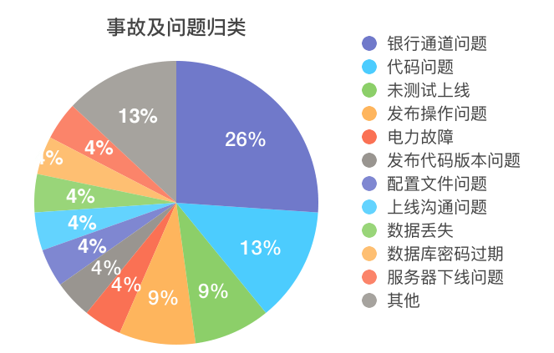



1.1 Challenges faced by high availability (continued)
Categories of incidents and problems:
Code problems
Configuration problems
Performance problems
Jitters of tunnels/leased lines
ISP failures
Overall data center failures
Attacks
Hijacking
Internal
Provider
External threats

Slide 8
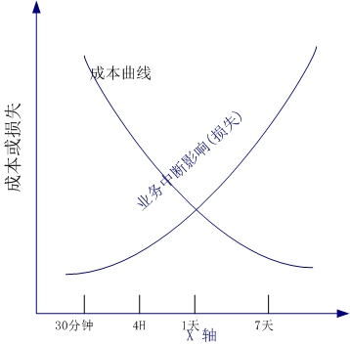
1.2 Overall planning for high availability
Overall planning for high availability:
  What level of high availability should the system achieve?
  What factors are related to the development of a high
  availability policy?
  How do we implement schemes for disaster recovery
  of data, application, and data center as well as
  active-active schemes?
  How do we plan an emergency failover drill for high-availability disaster recovery?

Slide 9
1.2 Overall planning for high availability (continued)
Recommended disaster recovery schemes for customers at different stages:
Stability stage
1. Data disaster recovery
2. Environment disaster recovery
3. Security protection
1. Data/Environment disaster recovery
2. Security protection
3. Multiple clusters in the same data center
4. Multiple data centers in the same region
1. Data/Environment disaster recovery
2. Security protection
3. Multiple clusters in the same data center
4. Multiple data centers in the same region
5. Multiple data centers in different regions
Growth stage
Startup stage

Slide 10
1.2 Overall planning for high availability (continued)
Overall planning:
  Layered design:
    Decouple the access layer from the service layer;
    Decouple the service layer from the data layer;
    Implement high cohesion and low coupling between layers;
    Support flexible scalability at different layers;
    Support redundant disaster recovery deployment at different layers;
    Support the set-based deployment of layers.

Slide 11
1.2 Overall planning for high availability (continued)
Abstract layered structure of the internet:
Web and terminal (iOS/Android/PC)
Client
OPS system (monitoring/release/data analysis/failover)
DNS/CDN
Security
Perimeter network
Access layer
Service layer
Business architecture layer
Middleware layer
Data layer
Resource
Basic environment layer
Data center/network
Notes:
互联网通用的架构分层，在这里做个抽象概括，如上图所示：
Web/端提供浏览器功能；
域名解析/CDN提供外层网络接入功能；
接入层：通常由CLB负载均衡器或nginx反向代理来充当；
服务层：往往承载的是业务应用，提供业务逻辑；
中间件层：更多的是在应用服务器和数据库之间提供数据缓存的功能，比如Redis、Memcache等缓存中间件；
数据层：通常情况下指的是数据库，当然一些非结构化数据的存储也可以归为此类；
基础环境层：机房、物理网络、服务器、存储等这些基础设施的硬件设备，不在本课程架构设计范畴；
通过以上归类分析我们发现，要想设计高可用的架构，简简单单的通过某一层来实现是不现实的，这里要设计整体架构的高可用，需要通过层层的高可用设计来满足；

Slide 12
1.2 Overall planning for high availability (continued)
Analysis of layers:
Layer/Module | Possible Problems/Risks | Requirements for High-Availability Disaster Recovery | Solutions
DNS/CDN | 1. Exceptional DNS resolution, rendering the services completely unavailable 2. Exceptional service of the single CDN service provider, making fast failover impossible | 1. The services can be used normally in the event of DNS hijacking or exceptions at the DNS service provider 2. The business can be resumed quickly after an exception occurs at the single CDN service provider | 1. Tencent Cloud DNS, which can improve the service capacity 2. HTTPDNS, which can solve DNS hijacking 3. Direct IP connection, as further described below 4. Connection to two CDN service providers for mutual backup
Security layer | 1. Large-Scale attacks, leading to service unavailability 2. Business and data security risks | 1. High-Bandwidth anti-DDoS capabilities, which allow for failover anytime 2. Elimination of business risks | 1. Connection to Tencent Cloud Anti-DDoS services 2. Security services such as CWP, TenDI, WAF, and KMS, which guarantee business security
Access layer | 1. Business interruptions caused by failures in the services of the single ISP in the single region 2. Single points of failures in the single cluster or single IP 3. Unstable access for global users or users in remote areas | 1. Access and scheduling from multiple regions 2. Coverage of multiple IPs and multiple ISPs 3. Nearby access for users | 1. BGP network 2. High-Availability CLB clusters and multi-region access 3. Anycast BGP IP
Service layer | 1. Single-Cluster service deployment 2. Single-Data center or single-region deployment of services without disaster recovery environments | 1. Single-Region high availability of services 2. Cross-Region high availability of services | As further described below
Middleware layer | 1. Distributed middleware deployment 2. Data consistency requirements for middleware | 1. Multi-AZ deployment 2. Multi-Region deployment | As further described below
Data layer | 1. Single points of failures in data without redundant backups 2. Failures in the single region, causing data unavailability 3. Challenges faced by the cost and reliability of self-backup of core data | 1. High reliability of core data 2. Controllable disaster recovery or costs | As further described below
Notes:
我们分析了互联网通用架构并做了抽象分层后，在这里做个简单的分层解析，如上表所示。

Slide 13
Section 2. Building High-Availability Architecture for the Outer Layer Network
Section 1. Evolution of Cloud Computing
2.1 Challenges faced by the outer layer network
CONTENTS
2.2 High-Availability design for the outer layer network
2.3 Design of the outer layer network based on Tencent Cloud services

Slide 14
2.1 Challenges faced by the outer layer network
Outer layer network:
  The network between the user request initiation and the service access;
Challenges faced by user access to the outer layer network:
Exceptional DNS resolution
Slow access
Notes:
用户进行外层访问，最终的结果要么是无法访问，要么是访问速度慢，体验很差，那么这里进行分析：
DNS解析的问题：用户不论是PC接入还是移动端接入去访问互联网应用，通常第一步解决的是域名解析问题，但域名解析过程中可能遇到比如DNS劫持的问题，缓存中毒问题等，如何应对？
访问速度慢的问题：用户发起访问到到网站源站，因为距离，跨运营商访问等原因造成访问延迟较大，用户体验不好。

Slide 15
2.1 Challenges faced by the outer layer network (continued)
Problems in the DNS resolution process:
  Exceptional local DNS cache:
    The local DNS cache is not updated in a timely manner, leading to access exceptions;
    The local DNS cache is altered, redirecting users to wrong pages;
  DNS forwarding, causing slow access:
    DNS requests are forwarded by multiple ISPs, causing slow DNS resolution;
    Users on the network of ISP A get the DNS resolution results for ISP B;
  DNS hijacking:
    DNS servers are hijacked and DNS records are deleted, thus causing DNS queries to be resolved incorrectly;
    DNS servers are hijacked and DNS records are altered, so that users are resolved to exceptional records.

Slide 16
2.1 Challenges faced by the outer layer network (continued)
Possible causes of slow access:
  The distance between the user and the accessed origin server is long;
  The user and the origin server are on networks of different ISPs;
  During hotspot events, promotions, or flash sales, origin server traffic surges, and the resources become insufficient as a result;
  The file resources accessed by the user are large, so loading is slow;
  The user's own network bandwidth is limited.
Notes:
用户访问速度慢：
用户与被访问源站之间距离较远，不可避免的当用户发起请求到源站请求资源时，延迟导致访问速度变慢；
用户与源站处在不同的运营商网络环境中，因为运营商之间的网络延迟，导致访问速度慢；
因为热点事件，比如某某明星退役赛，国庆大阅兵……源站流量突增，高并发的访问，导致用户访问速度变慢，甚至无法访问；
电商大促活动，导致短时间内网站的流量突增，源站过度繁忙，没有更多的资源处理和响应部分用户请求，导致无法访问；
用户访问的资源比较大，需要从源站下载到本地后查看，此时受限于互联网的带宽，延迟等因素，加载速度非常慢，甚至无法使用；
用户自己的网络带宽受限，形成网络瓶颈，导致访问速度非常慢；

Slide 17


2.2 High-Availability design for the outer layer network
To fix a DNS problem, the first step is to understand the DNS resolution process:
Local DNS
Root domain (.)
ISP DNS
Accesses www.qq.com
Returns the .com domain address
Accesses www.qq.com
Queries www.qq.com
Top-Level domain (.com)
Returns the IP address
Accesses www.qq.com
Returns the qq.com domain address
Returns the IP address
Queries www.qq.com
Returns the www.qq.com domain IP address
Second-Level domain (qq.com)
User
Notes:
DNS解析的基本原理：
用户向本地DNS发起www.qq.com的访问请求，本地DNS首先查看本地缓存是否有相关记录，如果有则返回给用户那么解析结束，如果没有往往会把请求提交给运营商的DNS；
运营商DNS收到www.qq.com的域名解析访问请求后，向根域服务器发起www.qq.com的访问请求，此时根域服务器返回.com域名的服务器地址；运营商DNS服务器根据返回地址向.com域名服务器发起请求，.com域名服务器返回qq.com域名服务器地址，运营商DNS服务器根据返回地址向管理二级域名qq.com的服务器发起www.qq.com的访问请求，qq.com服务器作为qq.com域名的权威服务器给运营商DNS服务器响应，解析成功则将解析地址返回给运营商DNS，返回给LocalDNS，最终把结果返回给用户，如果解析不成功，也会把权威的否结果经过层层DNS传递，最终返回给用户。

Slide 18
2.2 High-Availability design for the outer layer network (continued)
Solutions to DNS problems:
  Set reasonable aging time for DNS records or clear them regularly;
  Use real-time monitoring and follow up with service providers:
    Monitor the status of DNS records in real time and promptly notify the DNS service providers of any problems for quick solutions;
  Use smart DNS for scheduling and resolution:
    Use smart DNS scheduling services in the industry to ensure that the IP returned for a user is from the same ISP as the user;
  Directly use IP addresses:
    Place service IP addresses in the client in advance;
  Use HTTPDNS:
    Send DNS requests to the DNS server of Tencent Cloud over the HTTP protocol instead of sending them to the local DNS of the ISP over the DNS protocol.
Notes:
DNS问题的解决方法：
合理设置DNS记录的老化时间，让LocalDNS中的记录尽快到期，或定期清理DNS缓存记录，保证缓存记录的时效性；
实时监控+商务推进：
实时监控DNS解析记录的状态，及时的发现问题，商务上联系DNS提供方，推动问题的解决；
智能DNS调度解析：
结合行业内一些智能DNS调度的产品，保证用户拿到与用户相同运营商返回的IP；
直接使用IP地址：
提前预置服务IP地址列表到客户端，当需要访问服务时，直接使用本地提前预置的IP地址进行访问，避免了DNS异常的记录解析；
使用HttpDNS：
使用Http协议向腾讯云的DNS服务器发送域名解析请求，替代了基于DNS协议向运营商LocalDNS发起解析请求的传统方式，解决了移动互联网中DNS解析异常、域名劫持的问题；

Slide 19
2.2 High-Availability design for the outer layer network (continued)
For slow access problems:
  Deploy as many origin servers as possible in the regions covered by the business to shorten the distance between user and origin server;
  Connect services on origin servers to multiple ISPs and use third-party smart DNS services to enable nearby same-ISP access for users in different regions;
  During hotspot events or promotions, use resources in the cloud that scale automatically to handle high numbers of concurrent requests and increase the availability;
  Separate dynamic content from static content, use acceleration services or tools to speed up delivery, and reduce file size through compression to further accelerate delivery.
  Best recommendations:
  Rely on the auto scalability of cloud resources to alleviate the insufficiency of service capacity of origin servers;
  Leverage CDN's strengths of connection to the backbone networks of multiple ISPs and secure and reliable content delivery acceleration to deliver a better user access experience.

Slide 20
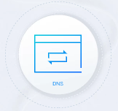
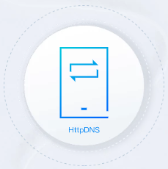

2.3 Design of the outer layer network based on Tencent Cloud services
List of Tencent Cloud services required for designing the outer layer network:
  Tencent Cloud DNS: is a smart DNS service provided over the entire network free of charge based on industry-leading DNSPod;
  HTTPDNS: sends DNS requests to the DNS server of Tencent Cloud based on the HTTP protocol;
  CDN: delivers website content to the high number of globally deployed cache nodes.
Direct client IP connection
Tencent Cloud DNS
HTTPDNS
CDN
Solutions to DNS problems
User access acceleration

Slide 21
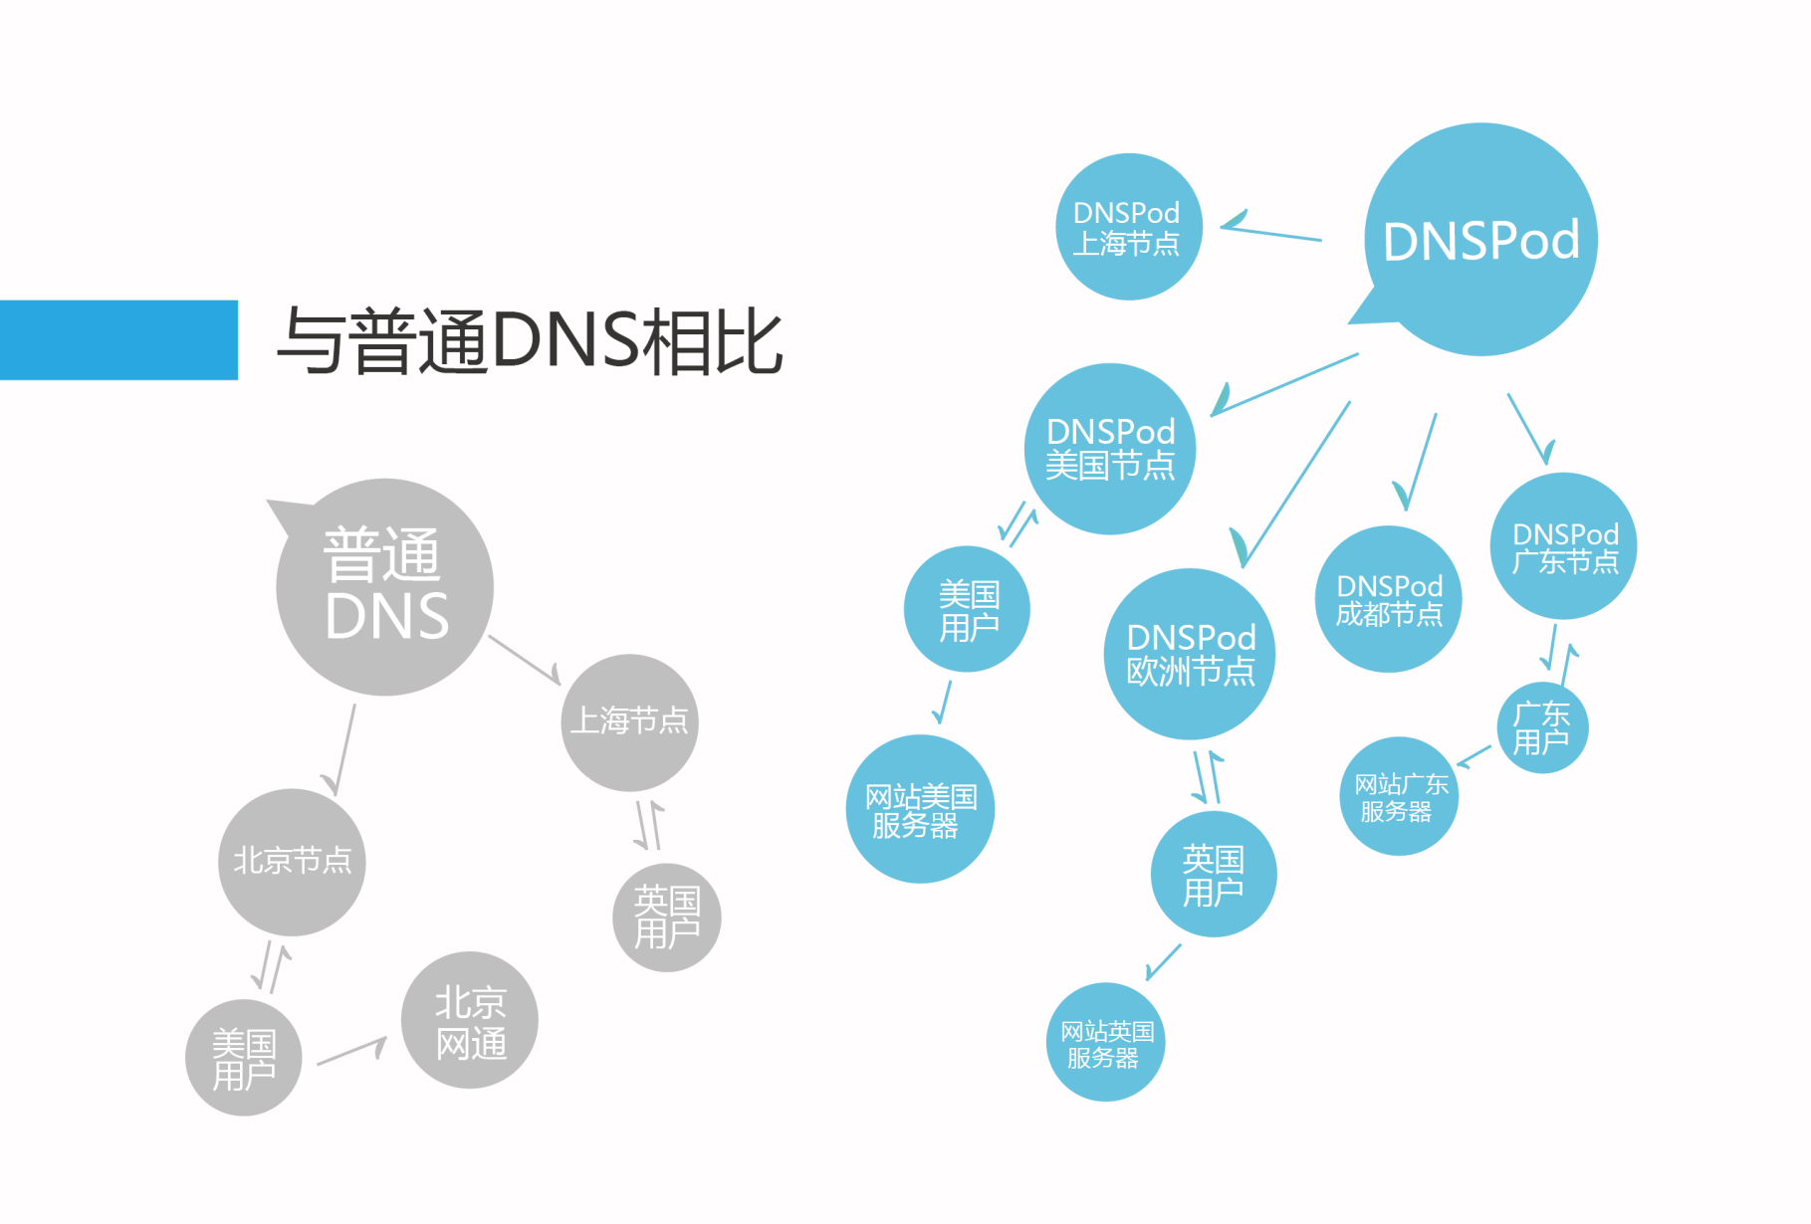
2.3 Design of the outer layer network based on Tencent Cloud services (continued)
  Use Tencent Cloud DNS instead of other DNS services
Local DNS
Accesses www.qq.com
Accesses www.qq.com
Returns the IP address
Returns the IP address
Tencent Cloud DNS
User
  Uses multi-node access, which supports smart DNS scheduling and guarantees nearby access for users;
  Supports flexibly setting the TTL for DNS records, solving the problem of DNS cache expiration;
  Supports categorizing and customizing split zones and selecting the optimal split zone as needed;
  Features fast DNS resolution, remote disaster recovery based on DNSPod, and DNS record sync in seconds;
  Has a DNS attack protection capacity of 200 Gbps.
Notes:
多节点接入，支持智能DNS调度：
DNSPod国内多地部署：共部署了40个境内集群节点，8个境外云集群节点，有超过463台服务器在同时提供专业解析服务；
灵活设置TTL时长，默认10分钟，也可根据不同套餐设置不同的TTL时长，保证本地DNS记录的时效性；
解析线路细分和自定义：
域名解析实时更新，目前支持移动，联通、电信等线路细分，更可设置海外，国内分省或自定义线路。
高安全防护：
DNSPod高并发请求实践验证：为超过650万域名提供解析，日处理DNS请求超过210亿次，每月成功防御DNS攻击超过2000次，每组用户套餐DNS攻击防御能力最低为200G；
解析速度快：
DNSPod支持异地容灾，解析秒级同步；
D监控-使用20余种独有算法，时刻监测网站，保证网站平稳运行，一旦网站服务器失去响应，立即切换到网站备用服务器，主服务器恢复后，自动回切；
支持CNAME解析加速，授权服务器会把 CNAME 记录和最终的 A 记录一次返回给递归，递归服务器由请求三次授权服务器，减小到请求一次，参考：https://cloud.tencent.com/document/product/302/5731

Slide 22
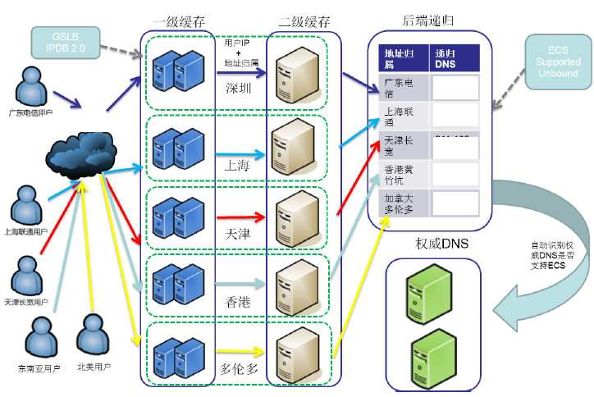
2.3 Design of the outer layer network based on Tencent Cloud services (continued)
  HTTPDNS is recommended in mobile internet scenarios
DNS requests are sent to the DNS server of Tencent Cloud based on the HTTP protocol instead of the local DNS of the ISP based on the DNS protocol, helping avoid domain name hijacking and cross-network access;
The client directly accesses the HTTPDNS API to get the optimal IP for the domain;
After the business IP is obtained, the client directly sends requests to it over the business protocol.
Q: how is the high availability of HTTPDNS itself guaranteed?
HTTPDNS
Notes:
HttpDNS 目的在于解决移动互联网中 DNS 解析异常、域名劫持的问题：
移动 DNS 的现状：运营商 LocalDNS 出口根据权威 DNS 目标 IP 地址进行 NAT，或将解析请求转发到其他 DNS 服务器，导致权威 DNS 无法正确识别运营商的 LocalDNS IP，引发域名解析错误、流量跨网。
域名被劫持的后果：网站无法访问（无法连接服务器）、访问到钓鱼网站等。
解析结果跨域、跨省、跨运营商、国家的后果：网站访问缓慢甚至无法访问。
腾讯云HttpDNS服务优势：
根治域名解析异常：由于绕过了运营商的 LocalDNS，用户解析域名的请求通过 HTTP 协议直接透传到了 HttpDNS 服务器 IP 上，用户在客户端的域名解析请求将不会遭受到域名解析异常的困扰。
调度精准：HttpDNS 能直接获取到用户 IP，通过结合 DNSPod 自有专利技术生成的 IP 地址库以及测速系统，可以保证将用户引导的访问速度最快的 IDC 节点上。
成本低：接入 HttpDNS 的业务仅需要对客户端接入层做少量改造，无需用户手机进行 root 或越狱；而且由于 HTTP 协议请求构造非常简单，兼容各版本的移动操作系统更不成问题；总而言之，就是以最小的改造成本，解决了业务遭受域名解析异常的问题，并满足业务精确流量调度的需求。
扩展性强：HttpDNS 提供可靠的域名解析服务，业务可将自有调度逻辑与 HttpDNS 返回结果结合，实现更精细化的流量调度。例如，可指定某个版本的客户端连接指定的 IP 地址、某个网络类型的用户连接指定的 IP 地址等。

Slide 23
2.3 Design of the outer layer network based on Tencent Cloud services (continued)
  High availability of HTTPDNS itself:
    BGP Anycast network deployment: HTTPDNS is connected to the BGP Anycast network architecture to establish BGP interconnection with top 17 Chinese ISPs, which ensures that user requests from ISPs can quickly access the HTTPDNS server. More ISPs are being connected to ensure the fast service response.
    Remote disaster recovery and real-time failover: HTTPDNS has multiple nodes in multiple IDCs across China. If any node fails, it can seamlessly switch to a backup node to ensure the high service availability.
    For disaster recovery reasons, we recommend you retain your ISP's local DNS as a backup.

Slide 24
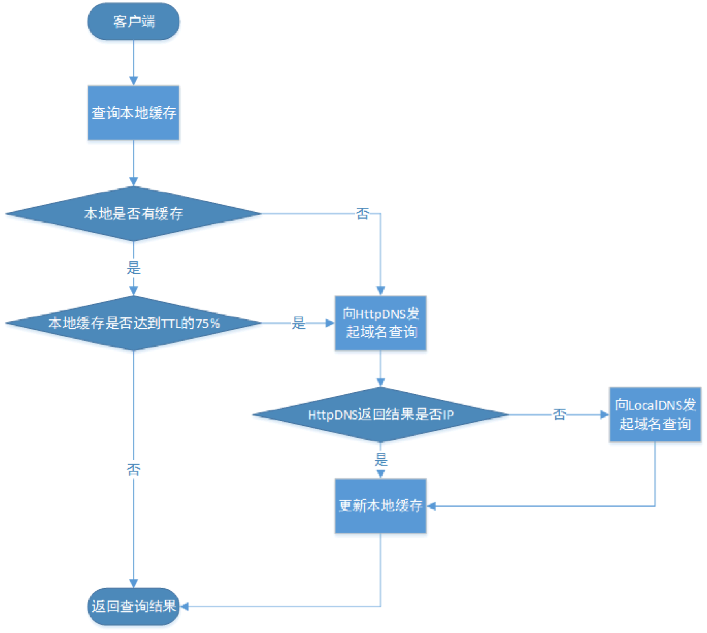
2.3 Design of the outer layer network based on Tencent Cloud services (continued)
Failover: when the result returned in response to a HTTPDNS query is not an IP address (empty, non-IP, or connection timeout), the DNS resolution will be performed by the local DNS;
Caching policy: to reduce the delay caused by DNS resolution, we recommend you cache DNS locally and set a reasonable TTL and update policy.
HTTPDNS service process
Notes:
HttpDNS业务流程：
当客户端访问网站时，先查询本地缓存，如果本地有相关域名记录的缓存，则验证本地缓存是否达到了TTL的75%，如果没有达到，则给客户端响应域名解析的结果；
如果本地缓存不存在，则向HttpDNS发起域名查询的请求，如果此时HttpDNS查询返回的结果不是IP，此时将向LocalDNS发起域名查询，将查询到的结果返回更新本地缓存，并将查询结果返回给客户端，当然如果HttpDNS查询返回的结果是正常的IP，将会更新本地缓存后返回给客户端。

Slide 25
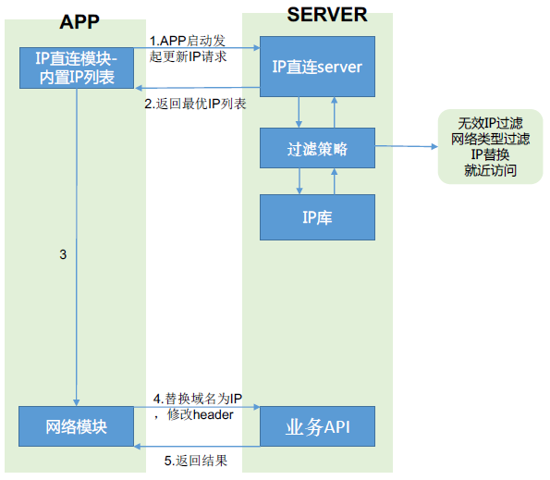
2.3 Design of the outer layer network based on Tencent Cloud services (continued)
  Direct client IP connection avoids DNS failures
In order to avoid DNS hijacking and HTTPDNS exceptions, we recommend you use direct IP connection instead of the current DNS scheme to ensure the business continuity and enable the default DNS scheme only when direct IP connection fails.
Strengths:
  Simplified DNS process for reduced time consumption;
  Accurate scheduling for reduced time consumption;
  DNS hijacking prevention;
  Disaster recovery capability when there are multiple IPs for terminals to access.
Notes:
业内对HTTP DNS在实际业务中的接入方式多采用IP直连的方式，即原本直接请求http://abc.tencent.com的地址，现在先调用SDK进行域名解析，拿到IP地址比如1.1.1.1，然后将访问的域名替换为http://1.1.1.1，向服务器发起HTTP请求。
首先，对于 HTTP 请求，采用 IP 直连的方案后，我们还是需要进行的一个操作是手动配置 Header 中的 HOST :
URL htmlUrl = new URL("http://1.1.1.1/");
HttpURLConnection connection = (HttpURLConnection) htmlUrl.openConnection();
connection.setRequestProperty("Host","www.meitu.com");
用户发送网络请求,因多种原因导致网络的return code不为200，当累计次数>5次时启动IP直连功能。IP直连模块会从备选的IP列表中获取IP地址，再次尝试访问。如访问失败继续使用下一个IP项，如此循环直到找到可以使用的IP。当IP列表遍历结束并且没有找到可用IP时切换回域名访问，放弃切换操作，初始的IP列表在app打包时埋入的默认IP。

Slide 26
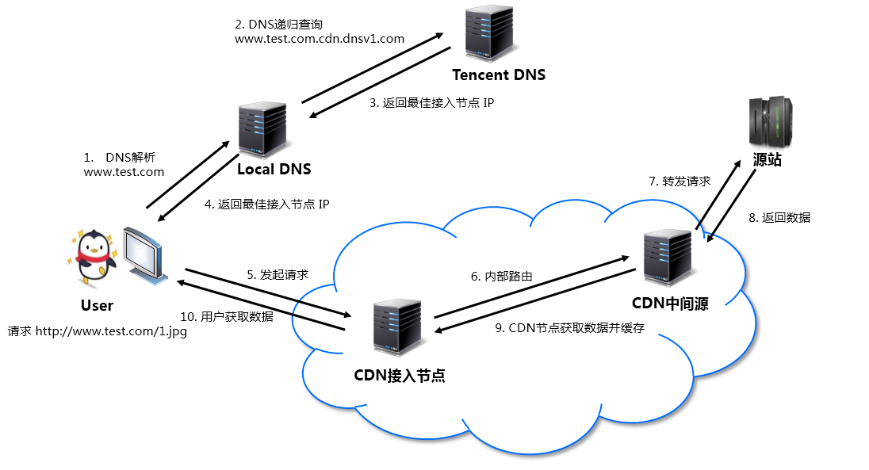
2.3 Design of the outer layer network based on Tencent Cloud services (continued)
  CDN:
Tencent Cloud CDN has over 1,100 cache nodes across China and over 200 nodes in more than 50 countries and regions.
It covers major ISPs such as China Mobile, China Unicom, and China Telecom, as well as small and mid-sized ISPs such as China Mobile Tietong and Great Wall Broadband Network.
Tencent Cloud's proprietary GSLB scheduling system and smart routing technology guarantee that requests will be routed to the closest and optimal CDN nodes;
Based on real-time status monitoring over the entire network and the smart routing technology, CDN can select the optimal origin-pull linkage to ensure the fast access to resources.
How CDN works
Notes:
CDN首先要解决的是南北互通，也就是电信和联通互通的问题，因为电信的网络访问联通的会很慢，而联通的网络访问电信的也会很慢，这算是一个具有中国特色的问题，解决方案也很简单，CDN支持让电信的用户访问电信的服务器，让联通用户访问联通的服务器。
客户通过嵌入SDK, 不经过传统 DNS 解析方式来使用 CDN 资源. 例如：HttpDns。
安全可靠，访问透明：提供多样化的访问控制策略（黑白名单保证安全性）；HTTPS支持：支持所有节点HTTPS传输，业务要求较高安全性，可上传自己的证书或腾讯云提供的免费证书上传至CDN节点进行部署；HTTP DNS直通车防止域名被劫持的风险；

Slide 27
2.3 Design of the outer layer network based on Tencent Cloud services (continued)
  Multi-Layer CDN cache design:
Disadvantages of CDN cache:
When the website is updated, if the data on CDN nodes is not updated promptly, even if the user uses the Ctrl + F5 combination to invalidate the cache in the browser, an access exception will occur due to the failure of the CDN edge servers to sync the latest data.
Solution:
Set a reasonable cache expiration time;
For new resource release or non-compliant resource cleanup scenarios, use the cache purge feature to clear the resource cache;
Actively prefetch the data updated on origin servers.
Edge layer
Cache cluster
Cache cluster
……
Cache cluster
Intermediate server
Cache cluster
Cache cluster
Cache cluster
Application cluster
Application cluster
Application layer
Storage layer
Notes:
多级CDN缓存：
边缘层：CDN系统中，直接面向用户，负责给用户提供内容服务的的Cache设备都部署在整个 CDN网络的边缘位置，所以将这一层称为边缘层。
中间源层：CDN系统中，中心层负责全局的管理和控制，同时也保存了最多的内容Cache。在边缘层设备未能命中Cache时，需要向中心层设备请求；而中心层未能命中时，则需要向源站请求。不同的CDN系统设计存在差异，中心层可能具备用户服务的能力，也可能只会向下一层提供服务。
CDN缓存策略：
CDN边缘节点缓存策略因服务商不同而不同，但一般都会遵循http标准协议，通过http响应头中的Cache-control: max-age的字段来设置CDN边缘节点数据缓存时间。
当客户端向CDN节点请求数据时，CDN节点会判断缓存数据是否过期，若缓存数据并没有过期，则直接将缓存数据返回给客户端；否则，CDN节点就会向源站发出回源请求，从源站拉取最新数据，更新本地缓存，并将最新数据返回给客户端。
CDN服务商一般会提供基于文件后缀、目录多个维度来指定CDN缓存时间，为用户提供更精细化的缓存管理。
CDN缓存时间会对“回源率”产生直接的影响。若CDN缓存时间较短，CDN边缘节点上的数据会经常失效，导致频繁回源，增加了源站的负载，同时也增大的访问延时；若CDN缓存时间太长，会带来数据更新时间慢的问题。开发者需要增对特定的业务，来做特定的数据缓存时间管理。
CDN缓存刷新：

Slide 28
Notes:
CDN边缘节点对开发者是透明的，相比于浏览器Ctrl+F5的强制刷新来使浏览器本地缓存失效，开发者可以通过CDN服务商提供的“刷新缓存”接口来达到清理CDN边缘节点缓存的目的。这样开发者在更新数据后，可以使用“刷新缓存”功能来强制CDN节点上的数据缓存过期，保证客户端在访问时，拉取到最新的数据。

Slide 29
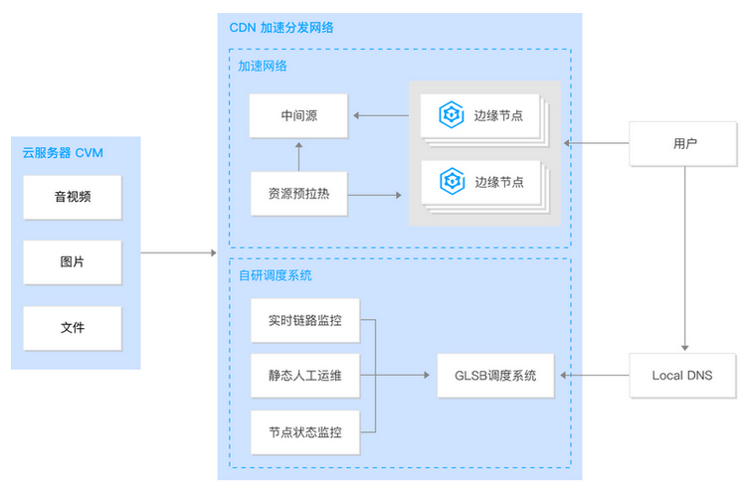
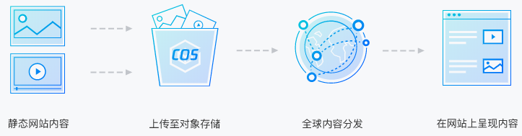
2.3 Design of the outer layer network based on Tencent Cloud services (continued)
  Best practices of CDN:
CDN + CVM
CDN + COS
Notes:
CDN+CVM分发实践：
腾讯云 CDN 可对用户在 CVM 上托管的的静态资源（如大量音视频、图片、文件等资源）进行全球加速分发。利用腾讯云 CDN 全球加速节点和调度的能力，可以将热点资源提前下发至边缘节点，当终端用户发出资源访问 / 下载请求的时候，可就近获取所需要的资源。
操作方法上：将 CDN 上的加速域名与 CVM 域名或 IP 地址绑定，同时开启 CDN 加速服务。
CDN+COS分发实践：
腾讯云 CDN 可对 COS 上存储的静态资源（包括静态脚本、音视频、图片、附件等文件）进行全球加速分发。利用腾讯云 CDN 全球加速节点和调度的能力，可以将热点资源提前下发至边缘节点，当终端用户发出资源访问 / 下载请求的时候，可就近获取所需要的资源。降低了源站压力，减少了传输延迟，显著提升用户体验。
操作方法上：CDN上操作，将 COS 域名指向 CDN 加速域名，再将用户域名绑定到 CDN 加速域名或COS上操作，将用户域名绑定到 COS 域名，同时开启 CDN 加速。

Slide 30
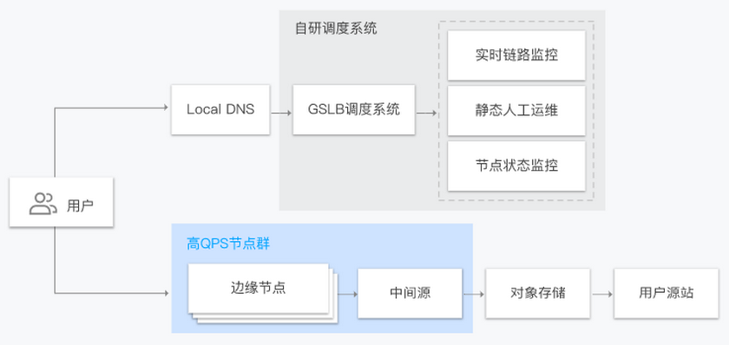
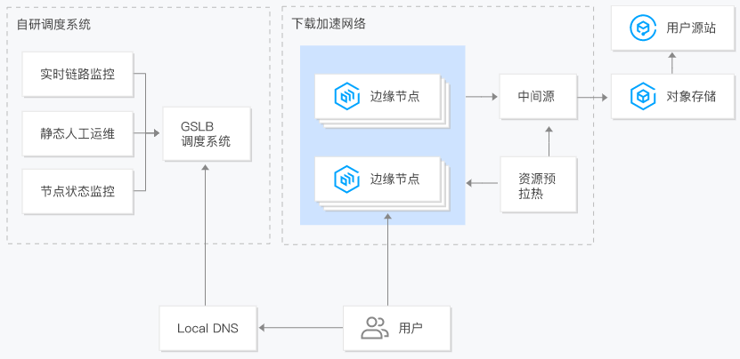
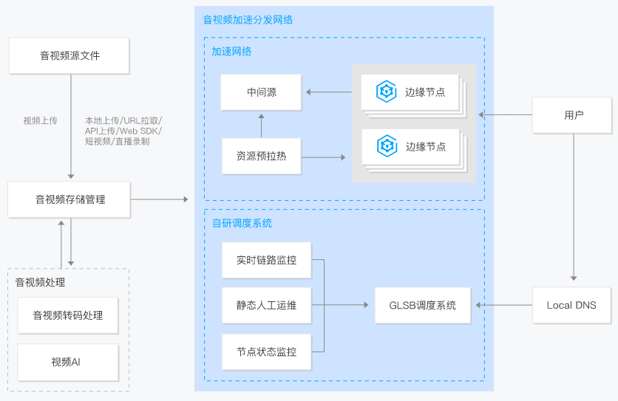
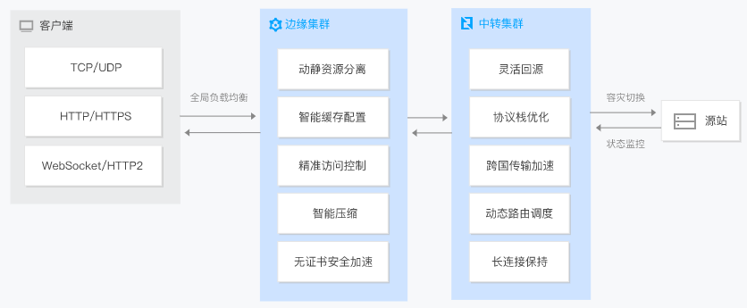
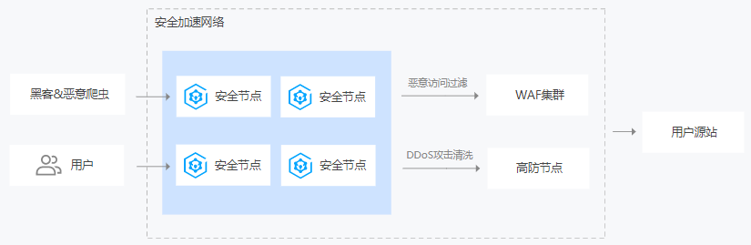
2.3 Design of the outer layer network based on Tencent Cloud services (continued)
  Use cases of CDN:
Website acceleration
Download acceleration
Audio/Video acceleration
ECDN
SCDN
Notes:
网站加速：适用于各类网站的加速，如门户网站、电商网站、UGC 社区等。腾讯云 CDN 可对站点内容中的静态内容，如各种类型的图片、网站 html、css 和 javascript 文件等进行缓存加速。对动态内容如网站中的 .asp、.jsp、.php、.cgi 和 .perl 文件、API 接口、数据库交互请求等加速；
下载加速：适用于各类文件下载的加速，如游戏安装包、手机 ROM 升级、应用程序包下载等。
音视频加速：适用于各种音视频点播网站和应用的加速，如各类音视频 APP、在线音视频网站、网络电视等。
全站加速：适用于动静资源混合或有较多动态资源请求（如 .asp、.jsp、.php、.cgi 和 .perl 文件、API 接口、数据库交互请求等）的网站和应用。
安全加速：适用于动静态内容加速和安全防护一体化的场景。尤其适用于那些既需要内容加速分发，又对安全防护有较高要求的行业，如游戏行业、互联网金融、电子商务网站、政务机构门户网站等。腾讯云安全加速 SCDN 在拥有 CDN 全部加速优势的基础上，提供超强的安全防护能力：防护大流量 DDoS 攻击，抵抗大型 CC 攻击，以及 WAF（网站入侵防护）。实时防护客户站点，保障业务稳定。

Slide 31
Section 3. Building High-Availability Architecture for the Access Layer
Section 1. Evolution of Cloud Computing
3.1 Challenges faced by the access layer
CONTENTS
3.2 High-Availability design for the access layer
3.3 Design of the access layer based on Tencent Cloud services

Slide 32
3.1 Challenges faced by the access layer
Access layer:
  Load balancing layer that provides services;
Considerations for the access layer:
Load balancing redundancy
Load balancing security issues
Notes:
用户通过DNS解析后，发起对应用服务的访问，首先接入的是负载均衡设备，负载均衡服务是否可用，决定了是否能够访问到应用数据；
负载均衡作为应用的入口，如果面临安全威胁，比如遭遇DDoS攻击或流量高并发问题，也可能导致一部分用户无法访问应用；

Slide 33
3.2 High-Availability design for the access layer
Load balancing redundancy issues:
  Use DNS to achieve redundancy on multiple load balancers;
  Publish VIPs in multiple regions to enable nearby access for users and improve the load balancing availability.
Load balancing security issues:
  Use security services to cleanse the exceptional traffic that accesses load balancers before allowing access.

Slide 34


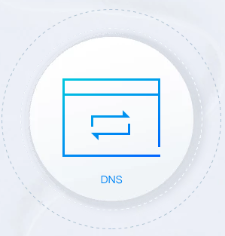

3.3 Design of the access layer based on Tencent Cloud services
List of services required for designing the access layer:
  CLB: provides a unified access entry to application servers;
  Anycast CLB: is a load balancing service that supports global dynamic acceleration. The CLB VIP is published in multiple regions around the world. The client connects to the nearest POP;
  Tencent Cloud DNS: provides reliable, stable, and authoritative DNS services based on industry-leading DNSPod;
  Anti-DDoS Advanced: defends businesses against high-traffic DDoS attacks by directing the attack traffic to Anti-DDoS Advanced IPs for cleansing, thus ensuring business stability and availability of the real servers.
CLB
Anycast CLB
Tencent Cloud DNS
Anti-DDoS

Slide 35
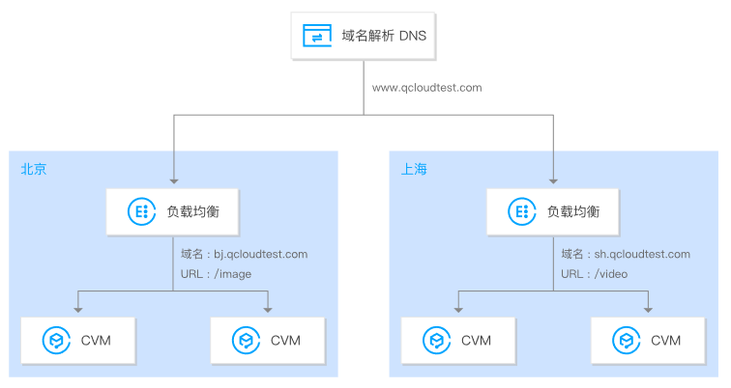
3.3 Design of the access layer based on Tencent Cloud services (continued)
Use Tencent Cloud DNS to improve CLB redundancy:
  Tencent Cloud DNS can be used to globally resolve the business traffic to CLB instances in multiple regions, guaranteeing multi-site active-active disaster recovery.
Notes:
云解析实现全局负载均衡：
您可以在不同地域部署负载均衡实例，并分别绑定对应地域的云服务器。
使用云解析将域名解析到各个地域的负载均衡 VIP 下。
业务流量会通过域名解析和负载均衡转发到多个地域的多个云服务器上，以此实现全局负载均衡。
当某个地域不可用时，暂停对应地域负载均衡 VIP 的解析即可保障业务不受影响。

Slide 36
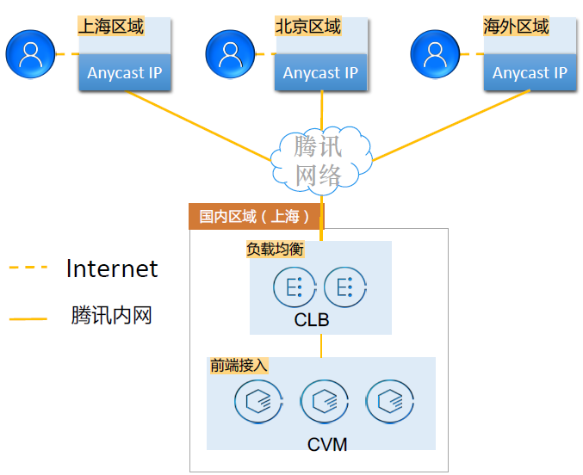
3.3 Design of the access layer based on Tencent Cloud services (continued)
Use Anycast IPs to improve user access availability:
  CLB uses Anycast IPs and publishes them over the Tencent network:
    CLB uses Anycast IPs and publishes them in multiple regions over the Tencent private network;
    Nearby access is provided for user requests, improving the user access experience in multiple regions.
Notes:
Anycast虽然解决了外网到CLB的访问可用性，但无法解决CLB和CVM本身的故障场景。

Slide 37
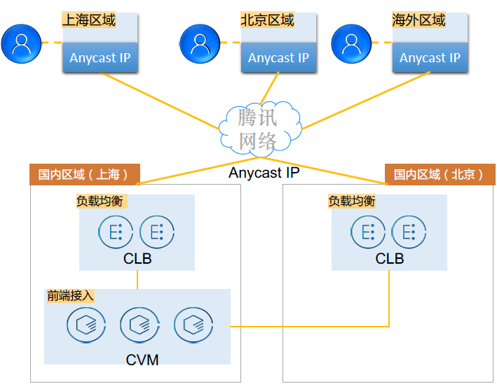
3.3 Design of the access layer based on Tencent Cloud services (continued)
Use Anycast IPs to solve CLB redundancy:
  CLB uses Anycast IPs and publishes them over the Tencent network:
    CLB uses Anycast IPs and publishes them in multiple regions over the Tencent private network;
    Nearby access is provided for user requests, improving the user access experience in multiple regions.
    Multiple CLB instances can be created simultaneously in different regions and bound to CVM instances through the cross-region feature of CLB.

Slide 38





3.3 Design of the access layer based on Tencent Cloud services (continued)
  Use Anti-DDoS and CLB in combination to improve CLB access security:
  Anti-DDoS protects businesses against high-traffic DDoS attacks;
  Five Anti-DDoS nodes deployed in China and dozens of ultra-large traffic cleansing centers deployed globally provide protection capacity at the Tbps level;
  30 exclusive BGP lines provide over 900 Gbps protection through one single node in China and up to 400 Gbps globally;
  Anti-DDoS can be connected to through internet proxy and supports TCP, UDP, HTTP, HTTPS, and HTTP/2 protocols.
Dynamic content acceleration
Static content acceleration
GAAP
Download and distribution acceleration
Audio/Video on demand acceleration
Notes:
相关核心概念：DDoS攻击，防护峰值，流量清洗，封堵

Slide 39
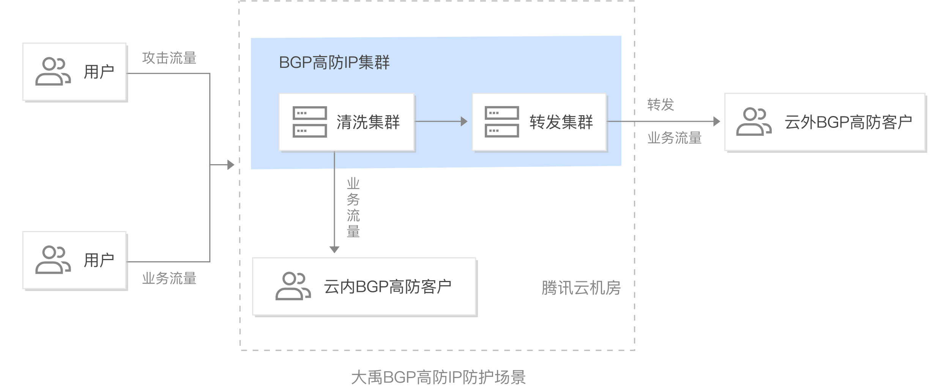
3.3 Design of the access layer based on Tencent Cloud services (continued)
  Anti-DDoS:
  Anti-DDoS provides defense against DDoS attacks at the network layer;
  Anti-DDoS Advanced can protect all types of servers on the internet, including but not limited to those in customer IDCs, Tencent Cloud, and other clouds;
  Anti-DDoS Advanced can be configured to replace the IP address of the real server in providing online services and direct all service traffic to its protective clusters, ensuring the stability and reliability of the services.
Notes:
BGP 高防原理：
基于大禹强大防护资源 + 精准清洗能力，为腾讯云内外服务器抵御大流量 DDoS 攻击。通过配置高防 IP，将替代源站服务器 IP 对外提供在线业务，所有业务流量都将牵引至大禹高防 IP 集群，确保源站服务的稳定可靠；提供弹性防护，保障业务连续性。
过滤 UDP Flood、SYN Flood、TCP Flood、ICMP Flood、ACK Flood、FIN Flood、RST Flood、DNS/NTP/SSDP 等反射攻击、空连接；

Slide 40
3.3 Design of the access layer based on Tencent Cloud services (continued)
Usage recommendations for Anti-DDoS:
  Switch online businesses to Anti-DDoS Advanced seamlessly:
    Technology dimension:
      Modify local hosts file instead of the DNS A record. The testing team should locally test and measure relevant performance metrics such as availability and latency.
      With an intelligent DNS product, you can change the A record for specified ISPs or regions, redirect a little amount of traffic to Anti-DDoS Advanced IP for test before fully applying Anti-DDoS Advanced to your business applications.
      Shorten the TTL of the DNS record for faster disaster recovery.
      Prepare a rollback plan in advance and back off as soon as any problem arises.
    Business dimension:
      Migrate standby and non-critical business applications first.
      Migrate the applications during off-hours.

Slide 41
3.3 Design of the access layer based on Tencent Cloud services (continued)
  Solutions to exposed real server IP:
    Some attackers may record real server IP history, and the exposed IPs allow them to bypass Anti-DDoS Advanced and directly attack your real server. In this case, you are recommended to change the actual real server IP.
    If you don't want to change the real server IP, or if you have already changed it but it is still exposed, to prevent attackers from bypassing Anti-DDoS Advanced and directly attacking the real server, we recommend you take the following action to protect the real server IP:
      To prevent attackers from scanning C range or other similar IP range, do not use the same IP or an IP similar to the old IP as the new real server IP.
      Prepare the standby linkage and IP in advance.
      Set the scope of access sources to prevent malicious scanning.

Slide 42
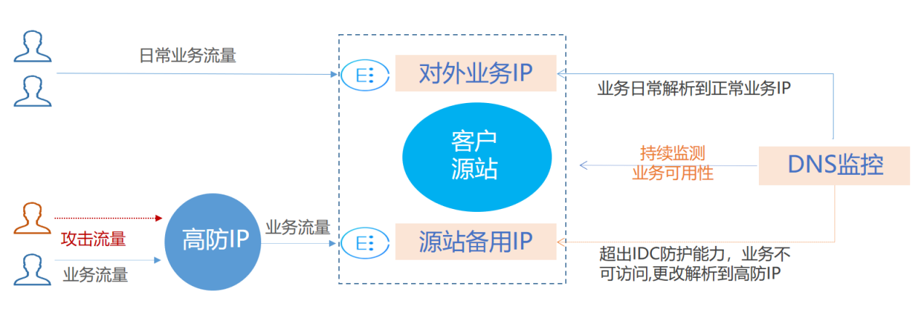
3.3 Design of the access layer based on Tencent Cloud services (continued)
  Anti-DDoS Advanced + real server
    You may consider real server-based protection scheduling if your customers have low tolerance for connection latency or if your business requires normal traffic to directly access the real server.
Real server-based protection scheduling scheme
Notes:
方案说明
本方案主要由高防 IP、DNS 监控、客户源站的对外业务 IP 和源站备用 IP 组成。
常态化情况下，业务的域名解析到正常的对外业务 IP，业务流量直接访问源站。DNS 监控实时监控源站业务是否可以正常访问。
当 DNS 监控检测到正常的对外业务 IP 无法访问时，依据智能切换的设置规则，迅速将业务域名解析到高防 IP 上。高防 IP 对攻击流量进行清洗，将干净的业务流量转发到源站的备用 IP，从而保障业务可用。
方案效果
满足常态化情况下直接访问源站的需求。
适用于对延时要求非常严格的业务。
遭到攻击超出源站防护能力后，可自动切换到高防 IP 进行防护。
建议与注意事项
需提前完成源站备用 IP、高防 IP 转发规则等配置。
建议将源站备用 IP 与正常的业务 IP 分布在不同的物理线路，以获得更好的防护效果。
建议定期进行验证和演练，熟悉方案细节，解决可能存在的问题。

Slide 43
3.3 Design of the access layer based on Tencent Cloud services (continued)
  Stress test for business systems:
    Adjust protection policies;
    Limit the traffic and number of requests in the stress test;
    Evaluate the possible impact of the stress test in advance;
    You may also need to consider other test-related factors, such as network bandwidth, linkage loads, and other basic resources.
Notes:
调整防护策略
建议关闭 CC 防护策略，如存在某些客观原因不能关闭 CC 防护策略，请将 CC 攻击防护的 HTTP 请求数阈值调整到压测最大值以上。
建议关闭 DDoS 防护策略，如存在某些客观原因不能关闭 DDoS 防护策略，请将 DDoS 防护的清洗阈值调整到压测最大值以上。
控制压测流量及请求数
建议将压测流量值小于1Gbps，否则将有可能触发攻击防护。
建议将压测的 HTTP 请求数限制在20,000QPS以内（即 HTTP 请求数每秒不超过20,000个），否则将有可能触发攻击防护。
建议将压测的每秒新建连接数小于50,000个，最大连接数小于2,000,000个，每秒入包量小于200,000个。
提前评估压测可能的影响
建议用户在压测前联系腾讯云架构师或 腾讯云技术支持，全面评估压测可能产生的影响及范围，制定合理的风险规避措施；

Slide 44
Section 4. Building High-Availability Architecture for the Application Layer
Section 1. Evolution of Cloud Computing
4.1 Challenges faced by the design of the application layer
CONTENTS
4.2 High-Availability design for the application layer
4.3 Design of the application layer based on Tencent Cloud services

Slide 45
4.1 Challenges faced by the design of the application layer
Considerations for the design of the application layer:
  How do we select software architecture?
  How do we plan application deployment capacity?
  How do we select the application deployment platform?
  How do we consider disaster recovery at the application layer?
  How do we guarantee the security of the application layer?
Notes:
大型分布式的集群，通过机器+集群内部拆分，具备了一定的可扩展性，但随着业务量的进一步增长，整个集群规模逐渐变的巨大，从而会在某个点达到瓶颈，无法满足扩展性需要，并且大集群内核心服务出现了问题，会影响全网用户；
核心服务（比如订单服务）挂掉，会影响全网所有用户，导致整个业务不可用；

Slide 46
4.2 High-Availability design for the application layer
Selection of software architecture:
  Traditional application or cloud native application
  Application scalability and capacity planning:
  Traditional application: consider CVM + CLB + AS and configure a scaling policy to automatically scale the resource pool
  Cloud native application: consider microservice + containerized deployment
Application disaster recovery issues:
  Multi-AZ and multi-region deployment for disaster recovery
  Set-based application deployment
Security design:
  Use application layer security protection services to strengthen the protection at the application layer;

Slide 47
4.3 Design of the application layer based on Tencent Cloud services
Application architecture:
Request
Request
LB
Service-Oriented splitting
LB
Web application module coupling
Vertical splitting of the web application
Apache
Java service
Tomcat
Service layer coupling
Vertical splitting of the service layer
JDBC
DB
Big database table coupling
Cost and efficiency
DB
DB
Database sharding and table splitting
Monolithic architecture
Frontend-Backend separation + microservice splitting
Notes:
要设计高可用的应用架构，首先需要了解应用架构的演进特征：传统的单体式架构下，不论是提供应用访问的web前端应用还是提供业务逻辑的服务模块，普遍呈现出聚合度高，扩展性差，不灵活的问题，可能上百个人维护一个服务核心工程，源代码冲突严重，错误难以隔离，协同成本极高，开发效率低，项目发布周期长，难以适应互联网场景下，海量负载、高并发，版本需要敏捷迭代，代码的持续集成，持续交付等需求的同时，保证应用的高可用性，因此对应用层的解耦势在必行，当然实际的企业环境下，依然存在这种单体式应用的模式，
分布式的服务架构成为了趋势和主流，这里可以将web应用进行垂直拆分成多个前端微服务，服务层也可以垂直拆分成多个提供业务逻辑的微服务模块，降低各个模块之间的耦合度，让每个微服务从开发到测试到发布部署都独立去完成，这里的独立包括开发团队的独立，开发语言的独立，对外提供服务的独立等特征，那么这里不得不考虑的问题是：各个微服务模块之间如何相互协同调用问题？微服务用什么工具来部署落地？如何设计分布式服务架构下的高可用？

Slide 48
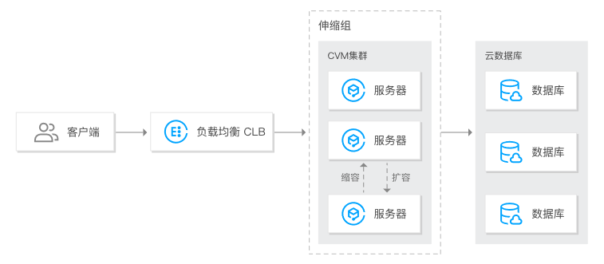
4.3 Design of the application layer based on Tencent Cloud services (continued)
High availability of traditional application: CLB + CVM + AS
  CLB can be used in combination with CVM to eliminate single points of failures on application servers;
  CVM can be used in combination with AS to automatically scale application systems as needed.
Notes:
CLB+CVM：
多台云服务器构成一个高性能、高可用的服务池，负载均衡将业务流量转发到这批云服务器上。
当某台或某几台云服务器不可用时，负载均衡可自动屏蔽故障的 CVM 实例，将请求分发给正常运行的 CVM 实例，保障应用系统正常工作。
会话保持功能可将同一客户端的请求转发到同一台后端云服务器，提高访问效率。
CVM+AS：
可以通过AS设定弹性伸缩策略来管理 CVM 实例数量，完成对实例的环境部署，并保证业务平稳顺利运行，在需求高峰时，自动增加 CVM 实例数量，以保证性能不受影响，当需求较低时，则会减少 CVM 实例数量以降低成本。

Slide 49
4.3 Design of the application layer based on Tencent Cloud services (continued)
Best practices of CLB + CVM + AS:
  Increase the service capacity of a CVM cluster by horizontal scaling, and increase that of a single CVM instance by vertically scaling its configuration;
  Use AS to automatically scale stateless services and plan the CVM cluster size for stateful services;
  If the business peak/off-peak hours are predictable, we recommend you use scheduled tasks for scaling;
  If the business peak/off-peak hours are unpredictable, or if you are afraid that AS may fail, we recommend you prepare a certain number of CVM instances in advance and configure them through manual scaling;
  Make good use of Cloud Monitor and the alarm notification mechanism to identify and solve problems in a timely manner.
Notes:
弹性伸缩CVM适合无状态服务：
伸缩组中的云服务器实例中部署的应用需要是无状态、可替换的，因为伸缩组中的实例有可能在缩容中被回收，所以用于弹性伸缩的 CVM 实例不能保存应用的状态信息（如会话）和相关数据（如数据库、日志等），如果应用中需要保存状态信息，可以考虑把状态信息保存到伸缩组以外的独立云服务器中。

Slide 50

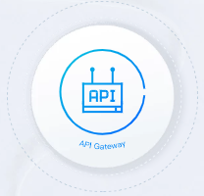

4.3 Design of the application layer based on Tencent Cloud services (continued)
Services involved in the deployment of a cloud native application:
  TSF: is a PaaS platform for applications and microservices and offers one-stop support for the management and digital operations of applications throughout their lifecycle;
  API Gateway: supports the management of APIs throughout their lifecycle from creation, maintenance, launch, and operation to deactivation;
  TKE: offers a container-centered, highly scalable, and high-performance container management service based on native Kubernetes.
TSF
API Gateway
TKE
Notes:
分布式服务化架构设计，可以使用腾讯云的TSF、API网关和TKE容器产品进行部署落地。

Slide 51
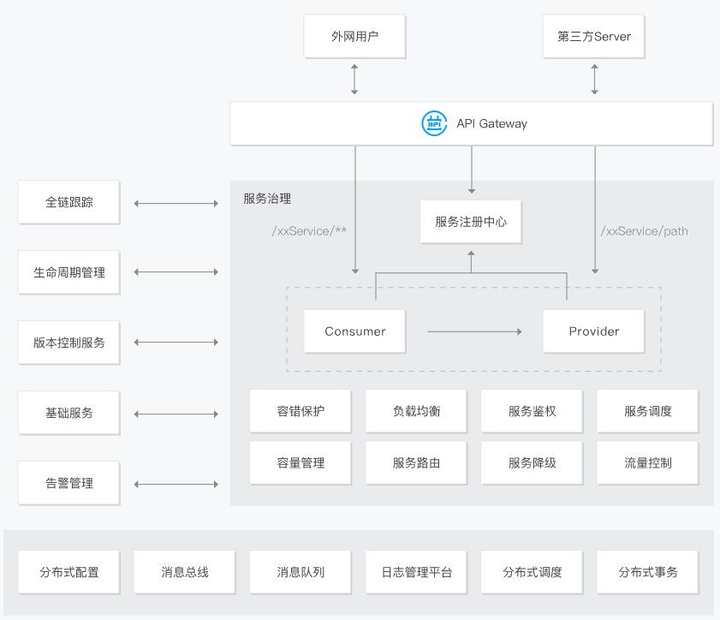
4.3 Design of the application layer based on Tencent Cloud services (continued)
Cloud native application deployment scheme:
  In terms of the overall distributed application framework, Tencent Cloud TSF provides the RESTful call method and the proprietary high-performance RPC framework. In terms of building high-availability and high-performance distributed systems, TSF systematically takes into account details such as distributed service discovery, routing management, security, and load balancing.
  In terms of application deployment, TKE can be used to build microservice clusters.
Notes:
腾讯微服务平台TSF围绕着应用和微服务的 PaaS 平台，提供应用全生命周期管理、数据化运营、立体化监控和服务治理等功能，TSF 拥抱 Spring Cloud 、Service Mesh 微服务框架，帮助企业客户解决传统集中式架构转型的困难，打造大规模高可用的分布式系统架构，实现业务、产品的快速落地。
TSF服务框架：
TSF 提供了 RESTful 调用方式和自研的高性能 RPC 框架，能够构建高可用、高性能的分布式系统，TSF 系统地考虑了分布式服务注册发现、路由管理、安全、负载均衡等细节问题。从图中我们还可以看到，分布式服务框架TSF具有容错保护、负载均衡、服务鉴权、服务调度、容量管理等功能，并且也具备告警管理、基础监控、版本控制服务、服务生命周期管理、全链跟踪等功能。这里以服务生命周期为例，TSF 提供从创建应用到运行应用的全程管理，包括创建、删除、部署、回滚、扩容、下线、启动和停止应用。除此之外，TSF还与腾讯云多款成熟中间件产品打通，包括腾讯云 API Gateway、消息队列 CMQ 、CKafka等，提供了全面的从应用部署到应用管理的全生命周期管理平台。

Slide 52




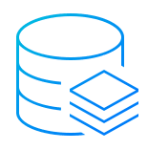
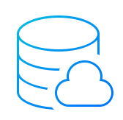
4.3 Design of the application layer based on Tencent Cloud services (continued)
Application disaster recovery design:
Single-Region disaster recovery:
  AZs communicate with each other over the private network, and the architecture of CLB + CVM + AS is used to achieve business disaster recovery;
  The access layer distributes traffic across AZs through CLB. If an AZ fails, CLB will automatically identify the failed servers and distribute the traffic to another AZ;
  The business layer is deployed across AZs to ensure high availability;
  Different AZs communicate with each other over the private network, thus saving costs.
Tencent Cloud DNS/HTTPDNS
Region 1
CLB
AZ A
AZ B
AS
Redis
Redis
TencentDB
TencentDB
Notes:
同地域多可用区：增强系统的容灾能力
数据库跨可用区主备，主从自动同步，出现故障自动切换到备库；
跨可用区部署只读从库，读请求本可用区完成，写请求内网写入主库；

Slide 53

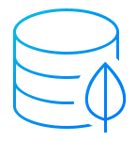
4.3 Design of the application layer based on Tencent Cloud services (continued)
Application disaster recovery design:
Cross-Region disaster recovery:
  Intra-Region active-active architecture for remote disaster recovery;
  AZs communicate with each other over the private network through peering connection or CCN;
  If the main entry fails, access will be switched to the disaster recovery region through DNS.
Tencent Cloud DNS/HTTPDNS
Region 1
CLB
Region 2
CLB
AZ A
AZ B
AZ A
CVM
AS
Peering connection
Redis
Redis
Redis
MongoDB
MongoDB
TencentDB
TencentDB
TencentDB
Notes:
适用场景：
对某些行业或业务系统，系统高可用要求非常高，同城容灾不能满足需求，业务要求跨地域容灾，此时的两地三中心模式非常适合。
跨地域部署：增强应用的异地容灾能力
数据库通过CDB容灾实例在异地做备份；
跨地域开启COS复制功能，实现对象存储数据的异地备份；

Slide 54

4.3 Design of the application layer based on Tencent Cloud services (continued)
Application disaster recovery design:
Tencent Cloud DNS/HTTPDNS
Multi-Region active-active architecture:
  Businesses are split into units for deployment;
  Each business unit is separately deployed in two regions;
  DNS scheduling supports nearby access for users;
  Main calls to a business unit are completed in a closed loop in the unit;
  In case of disasters, traffic is quickly switched to another region to achieve business disaster recovery while reducing disaster recovery costs.
Region 1
Region 2
CLB
CLB
AS
Peering connection
TencentDB
COS
TencentDB
COS
Notes:
适用场景：
异地灾备只有灾难发生时才会启用，资源利用率低，成本高，此时通过异地多活的方式，既实现了容灾的效果，又提高了资源利用率，降低了成本。

Slide 55

4.3 Design of the application layer based on Tencent Cloud services (continued)
Application disaster recovery design:
Tencent Cloud DNS/HTTPDNS
Hybrid cloud deployment:
  Deploy a complete set of business systems separately in the cloud and in the IDC;
  Use DNS scheduling to point the traffic ingress to Tencent Cloud and switch to the IDC in case of failures;
  Connect the IDC and the cloud over Direct Connect for interconnection on the private network;
  Make full use of Tencent Cloud's high-quality BGP public network and use resources in the IDC for sensitive businesses.
Tencent Cloud
IDC
CLB
Direct Connect/VPN
AS
CSG
Notes:
适用场景：
部署在IDC内的业务系统通常面临公网网络质量不好，扩容速度慢，无法灾备切换等问题；
解决方案：
本架构充分利用腾讯云优质的BGP网络接入，同时云上资源丰富，快速弹性，通过专线打通云上，云下，数据实时同步，故障时，可以切换到IDC做容灾；
混合云部署：
数据库通过专线做主备同步，利用存储网关，可以将数据备份到云上；

Slide 56
4.3 Design of the application layer based on Tencent Cloud services (continued)
User
Application disaster recovery design:
XXX SSO
cmdsvr
dispatch
extra
Unit A
cmdsvr
dispatch
extra
Unit B
cover
feeds
applistpage
cover
feeds
applistpage
Read svr
XX integrated cluster in Shenzhen
XX integrated cluster in Shanghai
Read svr
qza (gateway)
qza (gateway)
Data shuffling
Permission shuffling
Data shuffling
Permission shuffling
Update center
Profile
Contacts
Profile
Contacts
Write svr
Sync center
Write svr
Storage component
Storage component
Multi-Region active-active set-based deployment
Notes:
Set化的设计目标：
业务：解决业务遇到的扩展性和容灾问题，支撑业务的高速发展；
Set化架构：
每个set单元独立完成调用逻辑，比如UnitA内一套核心业务，比如网购，从加入购物车到下单，到支付，到仓库管理等要经过A、B、C等多个步骤，这些全部都在UnitA中进行部署，而UnitB是UnitA的备份，当UnitA中某个模块出现故障，则该模块请求路由到UnitB；
每个单元化集群只负责本单元内的流量处理，以及实现流量拆分及故障隔离，每个单元化集群前期只存储本单元产生的交易数据，后续会做双向数据同步，实现容灾切换需求；
Set化可以利用前端位置信息采集和域名解析策略，将流量路由由最近的SET，提供最高效的本地化服务，本单元内服务优先级最高，当本单元服务不可用，则路由到其他单元进行调用；
Set的切分和部署：理论上，切分规则由业务层面按需定制，建议优先选最大的业务维度进行切分；
一个SET并不一定只限制在一个机房，也可以跨机房或者跨地区部署；为保证灵活性，单个SET内机器数不宜过多（如不超过1000台物理机）
Set化建议：
业务单写多读，接入层识别读写操作，路由到不同SET；
异地多活成本和业务改造成本高，建议大体量的核心业务才考虑此方案；
业务具有条带化能力再考虑多地分布，避免set模型未规划好，产生大量的set间穿越流量；

Slide 57
4.3 Design of the application layer based on Tencent Cloud services (continued)
Application security
Web Application Firewall
Vulnerability Scanning
Mobile Security
Smart Application Gateway
Application security design:
Notes:
Web应用防火墙：腾讯云网站管家可以有效防御 SQL 注入、XSS 跨站脚本、木马上传、非授权访问等 OWASP 攻击。此外还可以有效过滤 CC 攻击、检测 DNS 链路劫持检测、提供 0day 漏洞补丁、防止网页篡改等多种手段全方位保护网站的系统以及业务安全。
漏洞扫描：腾讯云漏洞扫描服务是一款纯 SAAS 服务。客户无需安装任何硬件或软件，无需改变目前的网络部署状况。强大的并发扫描能力，可以为企业检测上千个网站，极大降低安全运维成本。
移动应用安全：移动应用安全为用户提供了一站式的服务体验，提供包括应用加固、安全测评、安全 SDK、适配测试、质量跟踪等功能。
应用级智能网关：应用级智能网关简称为腾讯云枢，是一款稳定、安全、高性能、易用的应用级智能网关，让用户高效快捷的访问企业应用和服务。腾讯云枢基于零信任策略，对企业应用和服务提供集中管控、统一防控和统一审计，保障企业应用和服务更安全、更可靠。

Slide 58
Section 5. Building High-Availability Architecture for the Middleware Layer
Section 1. Evolution of Cloud Computing
5.1 Challenges faced by the middleware layer
CONTENTS
5.2 High-Availability design for the middleware layer
5.3 Design of the middleware layer based on Tencent Cloud services

Slide 59
5.1 Challenges faced by the middleware layer
Why message queue?
  Application decoupling
  Sync task invocation
System B
System B
System C
System D
  Time consumption
  of 50 ms
  Time consumption
  of 50 ms
  Time consumption
  of 50 ms
System A
System C
  High numbers of concurrent access requests
  Write
  Concurrent user requests
System B
Database
System D
Traditional mode
Traditional mode
Notes:
系统间耦合的需要：系统A在代码中直接调用系统B和系统C的代码，如果将来D系统接入，系统A还需要修改代码，过于麻烦；
任务同步调用：一些非必要的业务逻辑以同步的方式运行，非常耗时间；
高并发访问的需求：用户高并发请求时，所有的请求，直接作用于数据库，造成数据库连接异常；

Slide 60
5.2 High-Availability design for the middleware layer
Middleware design:
  Application decoupling design
  Async communication design
System C
  Write
System B
Message queue
System B
Subscription
Subscription
  Time consumption of 50 ms
  Time consumption of 5 ms
System D
Write
System A
Message queue
System C
  Middleware mode
Read request
System D
  High numbers of concurrent user requests
Message queue
System B
Database
Middleware mode
Traditional mode
Notes:
系统解耦设计：消息写入消息队列，需要消息的系统自己从消息队列中订阅，系统A不用做任何修改；
将消息写入消息队列，非必要的业务逻辑以异步的方式运行，加快响应速度；
系统B慢慢的按照数据库能处理的并发量，从消息队列中慢慢拉取消息。在生产中，这个短暂的高峰期积压是允许的。

Slide 61
5.2 High-Availability design for the middleware layer (continued)
Other problems about middleware that need to be solved:
  What services should we select for middleware?
    There are open-source RabbitMQ and Kafka to choose from in the industry, and Tencent Cloud offers CMQ and CKafka for the same purposes;
  How do we consider the redundancy of the middleware itself? How do we implement multi-AZ and multi-region design?
    Middleware is deployed in a distributed and clustered manner in multiple AZs in multiple regions to achieve redundancy;
  If the redundancy of the middleware itself is guaranteed by cluster deployment, then how do we ensure data consistency across middleware nodes?
    Some algorithms that come with middleware services such as Raft guarantee data consistency.

Slide 62


5.3 Design of the middleware layer based on Tencent Cloud services
List of services required for the high availability of the middleware layer:
  CMQ: is a distributed message queue service that provides a reliable message-based async communication mechanism;
  CKafka: is a distributed, high-throughput, and high-scalability messaging system.
CMQ
CKafka

Slide 63
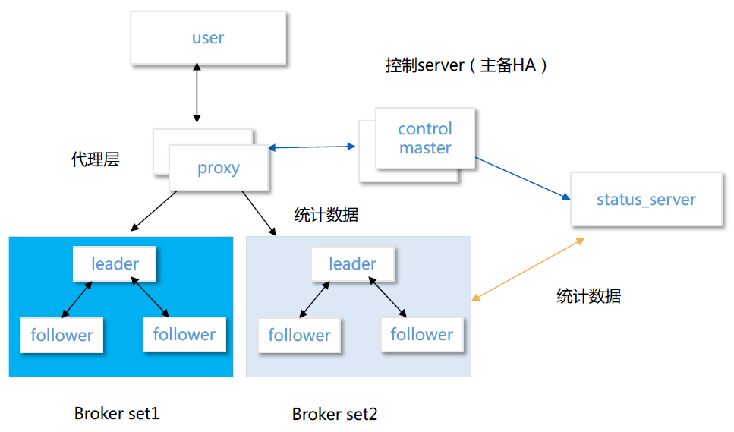
5.3 Design of the middleware layer based on Tencent Cloud services (continued)
CMQ
  Messages are stored in multiple copies, guaranteeing high reliability and strong consistency;
  The control master and proxy nodes are capable of automated failover;
  CMQ is scaled in a horizontal and transparent manner and delivers unlimited performance theoretically. Node loads are reported in real time. The scheduling policy is efficient and accurate;
  Consistent hashing reduces the inflammations caused by the horizontal scaling of the broker set;
  The Raft consensus algorithm guarantees the strong consistency of the stored messages.
Single-AZ high availability of CMQ

Slide 64
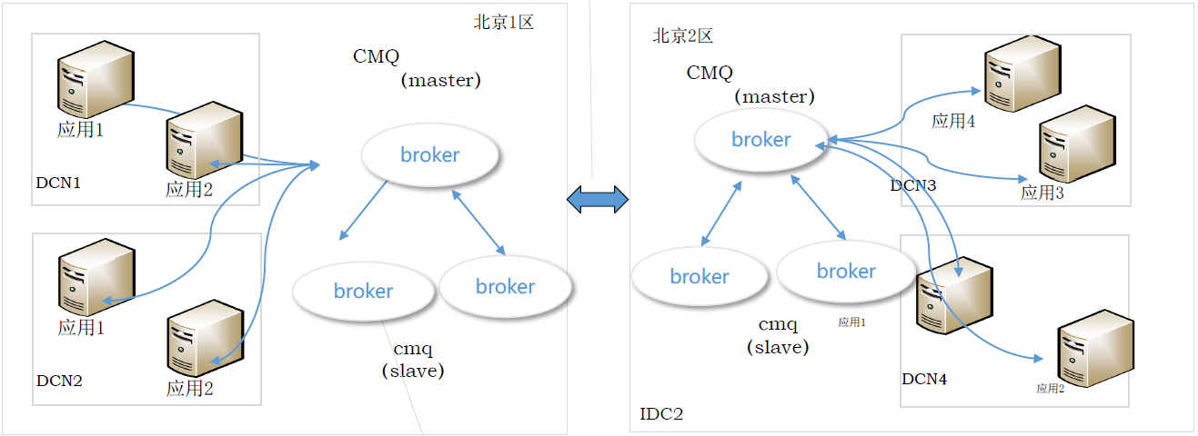
5.3 Design of the middleware layer based on Tencent Cloud services (continued)
Two sets of CMQ clusters are deployed in different AZs (Beijing Zone 1 and Beijing Zone 2) in the same region, and you can write messages to either zone based on actual needs;
Data is backed up to a different region;
Swapping policies can be opened as needed to achieve data isolation at the data center level;
Message data between primary and secondary nodes is strongly consistent;
Message data is stored locally and persistently according to policies (sync or async storage on disks);
Switches are made automatically between primary and secondary nodes without any impact on the application;
The RPO between the primary and secondary nodes is less than 5 minutes. When the MQ data on the primary node is completely lost, other databases can be associated with for processing such as reconciliation for data recovery.
Multi-AZ high availability of CMQ

Slide 65
5.3 Design of the middleware layer based on Tencent Cloud services (continued)
CKafka and Kafka
  CKafka is a high-performance and high-availability messaging middleware system developed by the Infrastructure Department of Tencent Cloud primarily for scenarios that require high performance, such as message transfer, website activity tracking, OPS monitoring, log aggregation, stream processing, event tracking, and log submission;
  CKafka is completely compatible with the Kafka protocol, enabling existing Kafka users to migrate to CKafka at no cost. It is developed and optimized based on existing Kafka features.
CKafka architecture:
  Producer: message producer
  CKafka cluster: uses ZooKeeper to manage the cluster configuration, elect the leader, implement fault tolerance, and do more in the cluster.
  Consumer: consumer

Slide 66
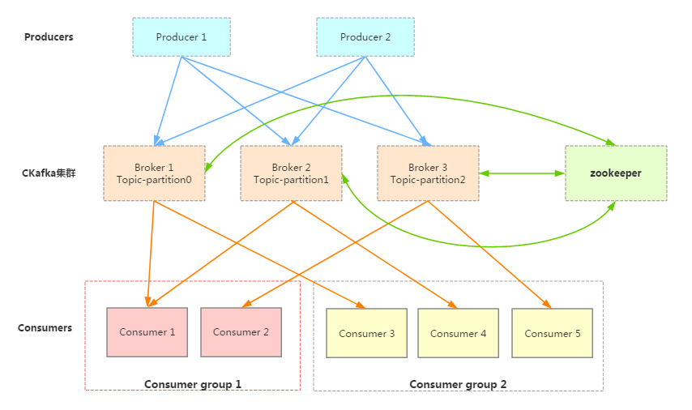
5.3 Design of the middleware layer based on Tencent Cloud services (continued)
CKafka architecture
Notes:
核心概念：
zookeeper集群：Kafka系统强依赖的组件。其存储了Kafka核心原数据 (如topic信息配置、broker信息、 消费分组等等，相当于DB充当了Kafka的配置管理中心) 。 Kafka的leader选举(如coordinator选举、controller选举、partition leader选举等等)，同样也会借助于zookeeper。
Consumer Group：消费分组，消费者标签，用于将消费者分类。可以简单的理解为队列，当一个消费分组订阅了一个topic则相当于为这个topic创建了一个队列，当多个消费分组订阅同一个topic则相当于创建多个队列，也变相的达到了广播的目的，而且该广播只用存储一份数据。
Broker：消息缓存代理，Kafka集群包含一个或多个服务器，这些服务器被称为Broker，负责消息的存储于转发，作为代理对外提供生产和消费服务。
Topic：消息主题(类别)，逻辑上的概念，特指Kafka处理的消息源的不同分类，用户可以根据自己的业务形态将不同业务类别的消息分别存储到不同Topic。用户生产和消费时只需指定所关注的topic即可，不用关注该topic的数据存放的具体位置。
Partition：Topic物理上的分组，在创建Topic时可以指定分区的数量，每个partition是一个有序的队列，按生产顺序存储着每条消息，而且每条消息都会分配一个64bit的自增长的有序offset(相当于消息id)。Partition是整个Kafka可以平行扩展的关键因素。
架构说明：
生产者 Producer 可能是网页活动产生的消息、服务日志等信息。生产者通过 push 模式将消息发布到 Cloud Kafka 的 Broker 集群。
集群通过 Zookeeper 管理集群配置，进行 leader 选举，故障容错等。
消费者 Consumer 被划分为若干个 Consumer Group。消费者通过 pull 模式从 Broker 中消费消息。

Slide 67
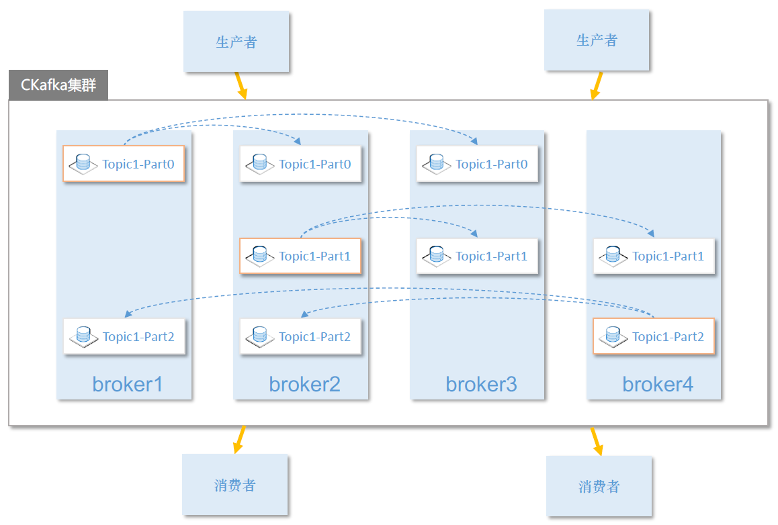
5.3 Design of the middleware layer based on Tencent Cloud services (continued)
The three-replica mechanism achieves high availability in the same AZ:
  The partition assignment algorithm ReplicaShift in CKafka makes it possible to provide redundancy for each broker node just like RAID 10, and failures in even half of the brokers in the cluster are imperceptible to the customer.
Notes:
CKafka文件存储机制CKafka文件存储中，同一topic有不同的partition,每个partition为一个目录，partition的命名规则为topic名称 + 有序序号(从零开始)，CKafka单机性能很强，但总会有上限，CKafka之所以能够无限平行扩展，在性能上碾压其他消息中间件，都是基于其partition概念，由于broker都是以partition为最小服务单位，对外提供服务，当增加partition就有可能分配到更多的broker为其服务，进而提高性能，当然这一切前提都是需要有个好的均衡算法让一个Topic的partition用分配到更多的broker为其服务。故partition能否均匀的分配到Kafka broker集群，直接影响到扩展性和性能。
算法步骤：
将所有活着的broker，按照broker id进行排序；
随机一个起始位置，选取一个最开始分配的broker这里命名为StartBroker，主要用于防止如果partition个数少且副本为1，如果不随机采用从头开始很容易导致partition的分配聚集在id小的broker上导致分配不均匀；
随机一个小于broker个数的随机数作为ReplicaShift，该值大小需保证为[1, broker count – 1]；
将partition的第一副本分配给StartBroker；
根据ReplicaShit计算第n(n>=2)个副本与第一个的偏移量，将其分配至相应Broker；
将StartBroker移至下一个Broker；
如果Broker以被轮询完一次，则增加ReplicaShift(主要为了可以更加均匀的分配副本)，然后分配下一个partition,从第4个步骤继续开始；

Slide 68
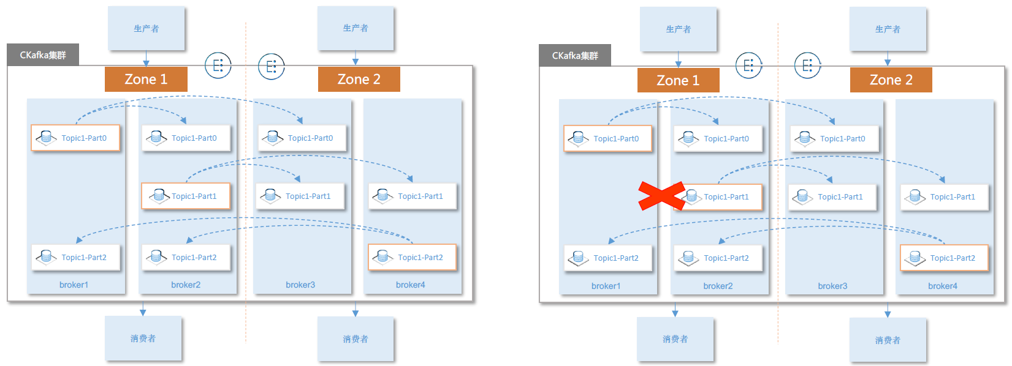
5.3 Design of the middleware layer based on Tencent Cloud services (continued)
Cross-AZ deployment of CKafka cluster:
  Strengths: brokers in a CKafka cluster are deployed in different AZs, and the same VIP provides services. Therefore, if an AZ fails, nodes in the secondary AZ will provide services;
  Risks: cross-region traversal involves high traffic and high latency.
Notes:
由于vip不变的方案，依赖内网LB的vip漂移能力，极端情况下需要生产消费的切换，需要修改broker ip的配置之后reload。

Slide 69
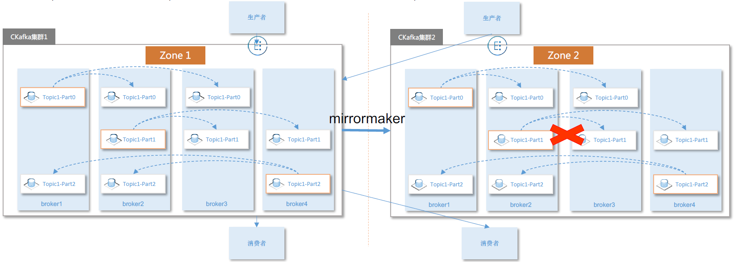
5.3 Design of the middleware layer based on Tencent Cloud services (continued)
Disaster recovery between two AZs:
  Strengths: a CKafka cluster is deployed simultaneously in both AZs, and the data in the primary AZ is synced to the secondary AZ through MirrorMaker. In case of failures in the primary AZ, the VIP remains unchanged, and the producer and the consumer will be switched to the CKafka cluster in the secondary AZ.
  Risks: the offset of the consumer will change, which may lead to a consumption failure in the backend consumer and cause the inability to sync the data completely.
Notes:
由于vip不变的方案，依赖内网LB的vip漂移能力，极端情况下需要生产消费的切换，需要修改broker ip的配置之后reload。

Slide 70
Section 6. Building High-Availability Architecture for the Data Layer
Section 1. Evolution of Cloud Computing
6.1 Challenges faced by the high availability of the data layer
CONTENTS
6.2 High-Availability design for the data layer
6.3 Design of the data layer based on Tencent Cloud services

Slide 71
6.1 Challenges faced by the high availability of the data layer
Considerations for the high availability of the data layer
  What are the data sources at the data layer?
  What data needs to be stored at the data layer?
  How do we guarantee the availability and reliability of the data at the data layer?
  How do we ensure data consistency for distributed data storage?
  How do we reduce costs while ensuring the secure and reliable storage of data?
Traditional mode

Slide 72
6.2 High-Availability design for the data layer
High-Availability design for the data layer:
  Data that needs to be stored at the data layer includes user data, product data, order data, transaction data, IM data, and other types of data;
  Categorization of data at the data layer:
    According to the format and call method:
      Document data: this type of data needs to be stored according to the file system hierarchy;
      File or image object call type: this type of data needs to be saved through COS;
      Relational data: this type of data needs to be stored in databases.
    According to the data access frequency:
      Hot data: priority is given to ensuring its availability;
      Cold data: it can be stored in the cold backup center or archived.
Traditional mode

Slide 73
6.2 High-Availability design for the data layer
High-Availability design for the data layer:
  Reliability and availability guarantee:
    Use mature third-party commercial services to implement data storage and guarantee reliability;
    Design a disaster recovery architecture for the data layer through read/write separation, redundancy, or backup;
  Data consistency:
    Multi-Replica data sync;
    Primary/Secondary replication.
  Cost optimization:
    Design different storage schemes for different data storage classes;
    Select low-cost Tencent Cloud services while guaranteeing availability and reliability.

Slide 74
6.3 Design of the data layer based on Tencent Cloud services
List of services required for the high availability for the data layer:
  CBS: provides a persistent block storage service for CVM;
  CFS: can be used in combination with services such as CVM, TKE, and BatchCompute to provide scalable high-performance shared storage for multiple compute nodes.
  COS: provides large-scale web API storage services, where you can call HTTP RESTful APIs to upload, download, and manage data.
  TencentDB: is the general term for the high-reliability, high-availability, and automatically scalable cloud storage services provided by Tencent Cloud.
Notes:
云硬盘CBS：云硬盘中的数据自动地在可用区内以多副本冗余方式存储，避免数据的单点故障风险，提供高达99.9999999%的数据可靠性。
文件存储CFS：CFS 提供了标准的 NFS 及 CIFS/SMB 文件系统访问协议，为多个 CVM 实例或其他计算服务提供共享的数据源，支持弹性容量和性能的扩展，现有应用无需修改即可挂载使用，是一种高可用、高可靠的分布式文件系统，适合于大数据分析、媒体处理和内容管理等场景。
对象存储COS：腾讯云 COS 的存储桶空间无容量上限，无需分区管理，适用于 CDN 数据分发、数据万象处理或大数据计算与分析的数据湖等多种场景。
腾讯云数据库产品家族：
关系型数据库：云数据库MySQL、云数据库MariaDB、云数据库SQL Server、云数据库PostgreSQL、分布式数据库TDSQL、云数据库CynosDB、数据库一体机TData
NoSQL数据库：云数据库Redis、云数据库MongoDB、云数据库Memcached、云数据库Hbase
分析型数据库及其他：时序数据库CTSDB、Snova数据仓库、数据传输服务DTS、腾讯云图TCV

Slide 75
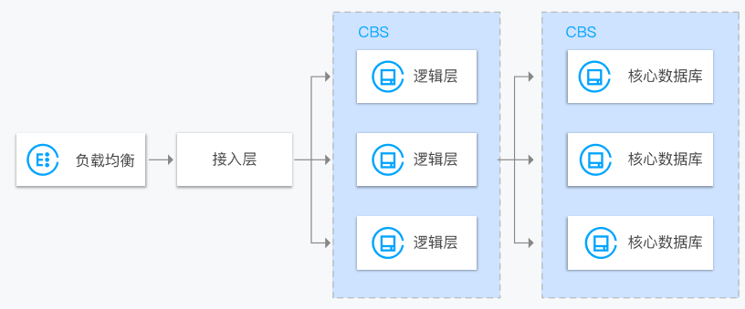
6.3 Design of the data layer based on Tencent Cloud services (continued)
Typical use cases of CBS
  Delocalization
  Analysis of massive amounts of data
  Core databases
Notes:
去本地化
高性能高可靠数据存储：云硬盘可高效地支持云服务器热迁移，提前避免物理故障带来的业务中断，云硬盘提供三份数据冗余，具备完善的数据备份、快照、数据秒级恢复能力。云硬盘适用于高负载、核心关键业务系统。
弹性扩容：云硬盘可在同一可用区内自由挂载、卸载，无需关闭/重启云服务器。云硬盘的容量可弹性配置，按需扩容。
海量数据分析
典型的 Spark-HDFS 离线数据分析框架对于磁盘的读写 RDD read/write、shuffle write 都是顺序 I/O，只有 shuffle read I/O 是随机 I/O，顺序 I/O 比例高达95%。云硬盘的多线程并发吞吐性能优秀，高效支持 Hadoop-Mapreduce、HDFS、Spark，TB/PB 级数据的离线处理。多磁盘并发，单 HDFS 集群可达到1GB/s的吞吐性能。
核心数据库
SSD 云硬盘适合对 I/O 性能要求高，同时对数据可靠性要求也高的场景。尤其适合如 PostgreSQL、MySQL、Oracle、SQL Server 等中大型关系数据库应用、对数据可靠性要求高的 I/O 密集型等核心业务系统以及对数据可靠性要求高的中大型开发测试环境。

Slide 76
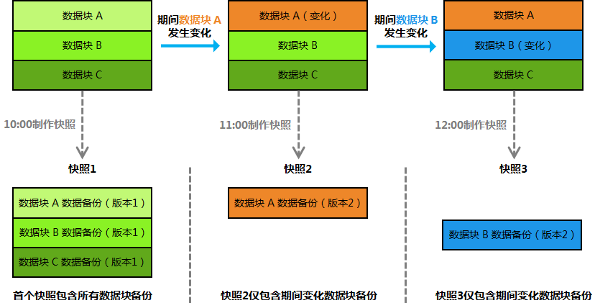
6.3 Design of the data layer based on Tencent Cloud services (continued)
The snapshot and recovery features of CBS can improve the availability
Notes:
腾讯云快照采用增量快照机制，当您对同一个云硬盘连续创建多个快照时，除了首个快照是全量快照以外，后续快照都只包含相对于前一个快照的数据变化部分（增量快照），这样可以最大限度的减少连续制作快照时的占据存储空间总容量，减少用户开销。
假设云硬盘内有3个数据块 A、B 和 C，您分别在10点、11点和12点为该云硬盘制作了快照。每个时间间隔中云硬盘上的数据块变化如下图所示，那么每个快照中应该存有以下数据：
快照1（首个快照）：包含当时云硬盘上所有数据块的数据备份（一般称为全量快照）
快照2：期间云硬盘上数据块 A 发生变化，快照2仅包含数据块 A 的最新数据备份
快照3：期间云硬盘上数据块 B 发生变化，快照2仅包含数据块 B 的最新数据备份
设计建议：
快照数据与生产系统隔离，快照与CBS云硬盘的数据默认跨机房存储，建议将快照数据存储到COS对象存储中保存；
建议开启定期快照策略：核心业务每天在业务低峰期自动制作快照；

Slide 77
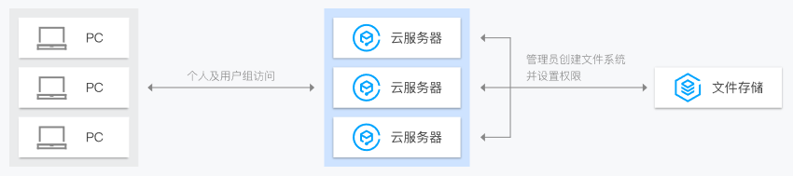
6.3 Design of the data layer based on Tencent Cloud services (continued)
Use cases of CFS:
  Enterprise file sharing
  Streaming media processing
  Web services and content management
  Big data application
Notes:
CFS应用场景：
企业文件存储：在拥有众多员工的企业中，员工办公需要共享和访问相同的数据集。管理员可以通过 CFS 创建文件系统，以便组织中的个人访问，还可为用户和组在文件或目录级别上设置权限。
流媒体处理：视频编辑、影音制作、广播处理、声音设计和渲染等媒体工作流程通常依赖于共享存储来操作大型文件。CFS 强大的数据一致性模型加上高吞吐量和共享文件访问，可以缩短完成上述工作所需的时间。
Web服务及内容管理：CFS 作为一种持久性强、吞吐量高的文件系统，可用于各种内容管理系统，为网站、在线发行、存档等各种应用服务提供数据源文件。
大数据应用：CFS 具备大数据应用程序所需的规模和性能，其计算节点高吞吐量、写后读一致性以及低延迟文件操作的功能及特性，特别适合服务器日志集中处理和分析。

Slide 78
6.3 Design of the data layer based on Tencent Cloud services (continued)
High availability of COS:
  As files are stored in COS, focus can be placed on reliability and the high availability of CDN origin-pull;
  High availability of files mainly guarantees the availability of file data and is primarily achieved through COS.
CDN
Primary/Secondary origin server configuration in CDN
COS in Beijing
COS in Shanghai
Cross-Region replication in COS
Tencent Cloud business server
Notes:
通过对象存储跨区域复制+CDN主备源站功能实现
数据会持续实时双向同步腾讯云两个地域Bucket
CDN默认回源主区域，当检测到回源异常后切换源站到备份区域
提供的改进主要针对：
COS所在区域入口紧张或接入集群异常情况下的回源
COS中数据的异地备份

Slide 79
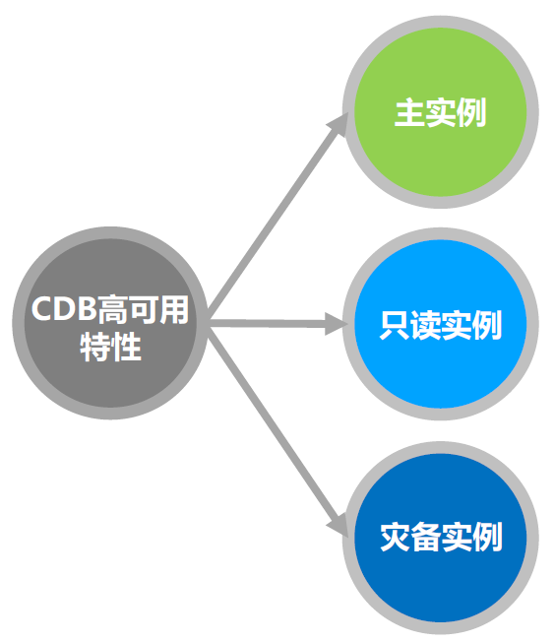
6.3 Design of the data layer based on Tencent Cloud services (continued)
High availability of TencentDB
  Read/Write instances and real-time primary/secondary hot backup guarantee high availability;
  Strong sync between one primary instance and two replica instances eliminates errors and disorder;
  Only read capabilities need to be developed to share the read load of the primary instance and achieve read/write separation;
  Remote disaster recovery meets the finance-grade requirements for cross-region disaster recovery;
  Multiple regions connect with each other through Direct Connect, with a delay of only 30 ms in sync between Guangzhou and Shanghai

Slide 80
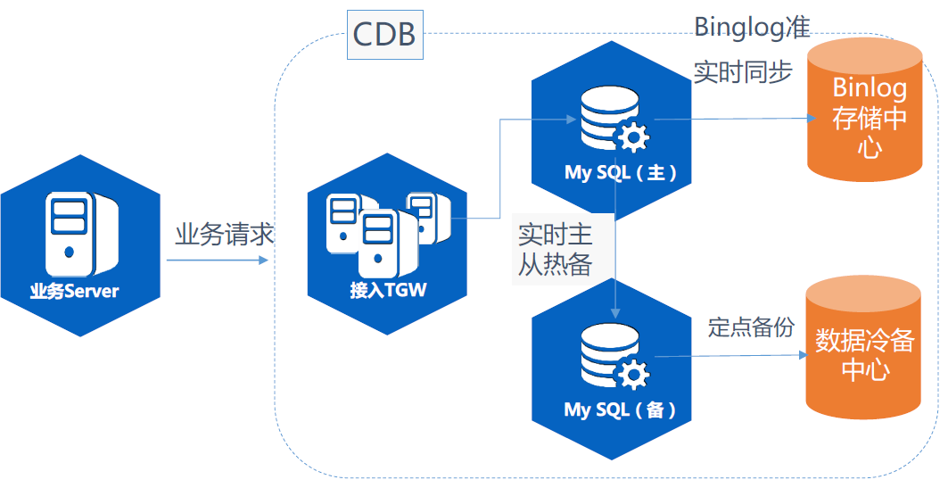
6.3 Design of the data layer based on Tencent Cloud services (continued)
High availability of TencentDB
Notes:
架构说明：
业务请求接入腾讯负载均衡TGW后，连接到MySQL主实例进行读写。MySQL的几乎所有操作会记录在binlog中，如果选购了高可用的MySQL主+备实例，二者之间会通过binlog的传输进行数据同步。一旦主实例故障，业务可快速切换到热备实例。同时主备实例可以分别发起对数据和binlog的备份，通过binlog实现无损失的数据保护，在误操作等特殊情况下仍具备数据恢复能力。
注意事项：
工信部可信云认证99.9996%数据高可靠性；
每日自动冷备，备份于业务低峰期在备机上完成，不影响现网业务；
每份冷备数据保存3份副本，保证数据不丢；
保留5天binlog日志供数据无损恢复；
支持5天内库、表粒度的任意时间点回档，最大限度保障数据准确性；
冷备文件和binlog日志均提供控制台和API下载；

Slide 81
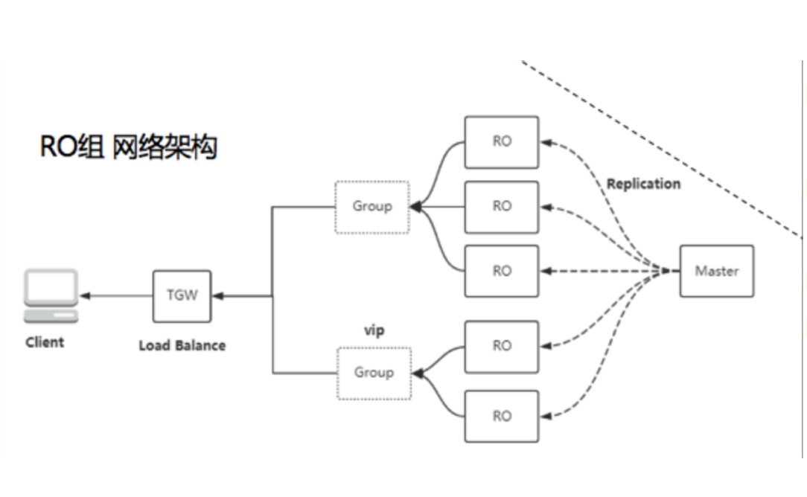
6.3 Design of the data layer based on Tencent Cloud services (continued)
Read/Write separation of TencentDB
  You can achieve RO load balancing in the RO group and customize weights;
  You can remove delayed or failed RO instances and customize the delay threshold;
  You can mount up to 5 RO instances;
  Read-only instances can help easily implement a one-primary-multiple-secondary and read/write separation architecture to sustain high volumes of business requests.
Notes:
在这些业务场景下，可以为主库创建多个只读数据库实例，用来分担客户端的读数据请求。其中：主库承担写入功能，主库每次写入数据后，会将数据自动同步到多个只读从库。只读从库实时接收主库的数据，形成只读副本，分担读压力。
腾讯云CDB读写分离支持1Master+5Slave（read only）的组合，并支持只读实例分组，通过vip实现组内负载均衡，实现高性能高可用高负载的一主多从、读写分离架构。

Slide 82
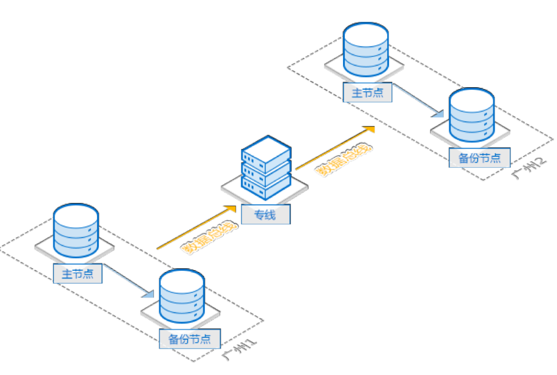
6.3 Design of the data layer based on Tencent Cloud services (continued)
Remote disaster recovery of TencentDB
  Data-Level disaster recovery
  Intra-Region multi-AZ disaster recovery
  Remote disaster recovery
  2-Region-3-DC
High-Availability architecture for cross-region disaster recovery
Notes:
数据级灾备：CDB灾备方案
利用专线，让用户可以选择自己的核心数据进行同城或异地热备容灾；
同城多可用区容灾：
同城不同机房中，将本地机房的一个实例，通过网络同步传输到另外机房；
异地灾备：
多地域之间不同机房互为冗余，可实现当一个机房发生故障无法提供服务，快速切换到另外一个机房；
两地三中心：
使用CDB，仅需页面简单配置几步即可实现两地三中心方案：
购买CDB同城强一致性集群，提供一地两中心能力；
为该集群添加异地灾备节点，即可实现两地三中心架构；

Slide 83
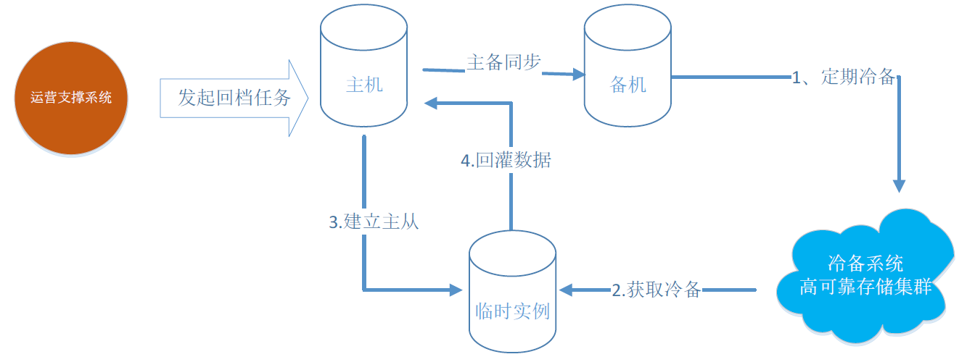
6.3 Design of the data layer based on Tencent Cloud services (continued)
Backup and rollback of TencentDB
TencentDB for MySQL supports two backup modes: logical backup and physical backup;
Logical backup supports exporting SQL files and enables the rollback of certain tables; therefore, it is suitable for scenarios that require fine-grained rollback;
Physical backup is fast and supports incremental backup, but it is necessary to roll back the entire instance; therefore, physical backup is suitable for scenarios where frequent data backup is needed;
The number of backups in both backup modes is three replicas by default, and both of them deliver a 99.9996% data reliability;
The rollback feature of TencentDB for MySQL supports performing batch operations on instances.

Slide 84
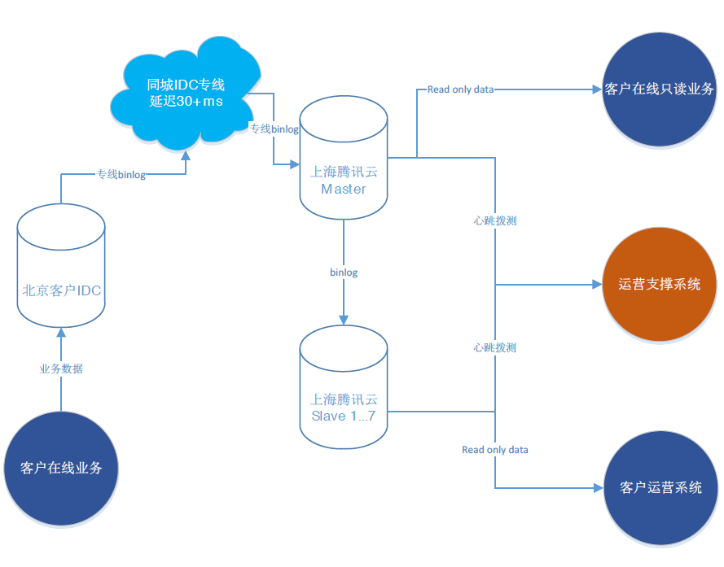
6.3 Design of the data layer based on Tencent Cloud services (continued)
Success story 1:
[Background]
A well-known O2O company migrated its business to Tencent Cloud in 2015. After it experienced explosive business growth, its original self-built databases could no longer sustain the rapid growth of its business.
[Solution]
In view of the characteristics of O2O business, databases of the highest specification were deployed for the user, order, and merchant systems, and seven read-only instances were created for each database;
One read-only instance was created for the user behavior log database for internal business queries and real-time data analysis.
Notes:
客户价值：
采用超高性能CDB for MySQL，并通过只读实例做读写分离和一主多从架构，极大的缓解了业务高速发展的数据库性能瓶颈；
只读实例增加了适合数据分析场景的多条索引，提升了查询效率，通过只读实例做查询也同时避免了对线上业务的影响；

Slide 85
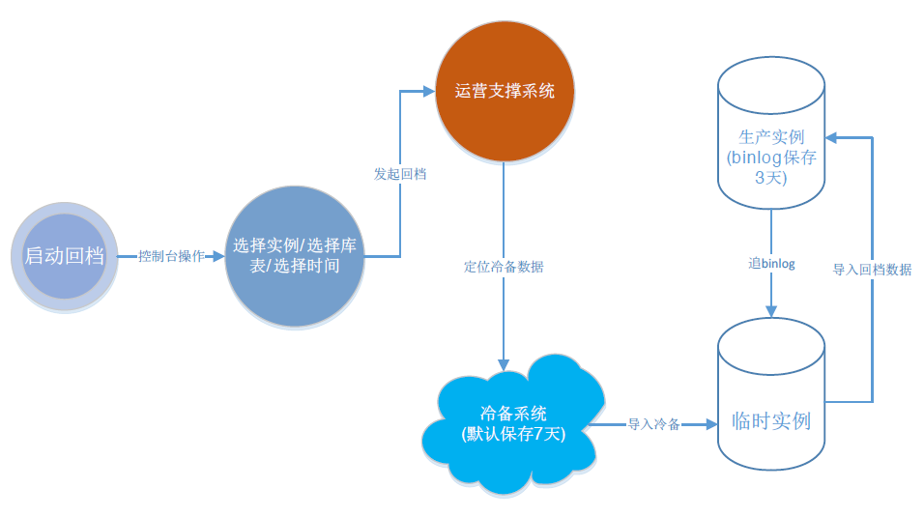
6.3 Design of the data layer based on Tencent Cloud services (continued)
Success story 2:
[Background]
A well-known gaming company received complaints from some users for the total loss of their gears, points, and coins, but the historical orders could not be accessed. Finally, this was found to be caused by the bugs in the new release, which led to confusion about the basic data of users above a certain level. As the game was zone-specific and server-specific, over 100 TencentDB instances and approximately 90 self-built MySQL instances were involved.
[Solution]
As TencentDB could be rolled back to any time point and supports batch operations, a rollback operation was initiated on over 100 TencentDB instances at the same time;
Concurrent replication was supported during TencentDB rollbacks, which greatly reduced the time required for rollbacks.

Slide 86
Reflection questions
Q1: what are the basic principles of designing a high-availability architecture in Tencent Cloud?
Q2: how do we design a high-availability architecture for the outer layer network?
Q3: how do we design a high-availability architecture for the access layer?
Q4: how do we design a high-availability architecture for the application layer?
Q5: how do we design a high-availability architecture for the middleware layer?
Q6: how do we design a high-availability architecture for the data layer?
Notes:
思考题相关产品要点：
问题一：外层-接入层-应用层-中间件层-数据层
问题二：挑战-思路-产品解决方案：云解析、HttpDNS、CDN、BGP高防IP
问题三：挑战-思路-产品解决方案：Anycast BGP IP、CLB、AS
问题四：挑战-思路-产品解决方案：传统应用：CLB+CVM+AS、云原生应用：TSF+API网关+TKE容器服务
问题五：挑战-思路-产品解决方案：CMQ+Ckafka的冗余性设计
问题六：挑战-思路-产品解决方案：不同类型数据存储解决思路CSB、CFS、COS、CDB

Slide 87
Course summary
This course covers:
  Principles of designing a high-availability architecture
  How to design a high-availability architecture for the outer layer network
  How to design a high-availability architecture for the access layer
  How to design a high-availability architecture for the application layer
  How to design a high-availability architecture for the middleware layer
  How to design a high-availability architecture for the data layer

